Slide 1
Predator Prey Ratio
Salmonid Working Group
5-3-19

Slide 2
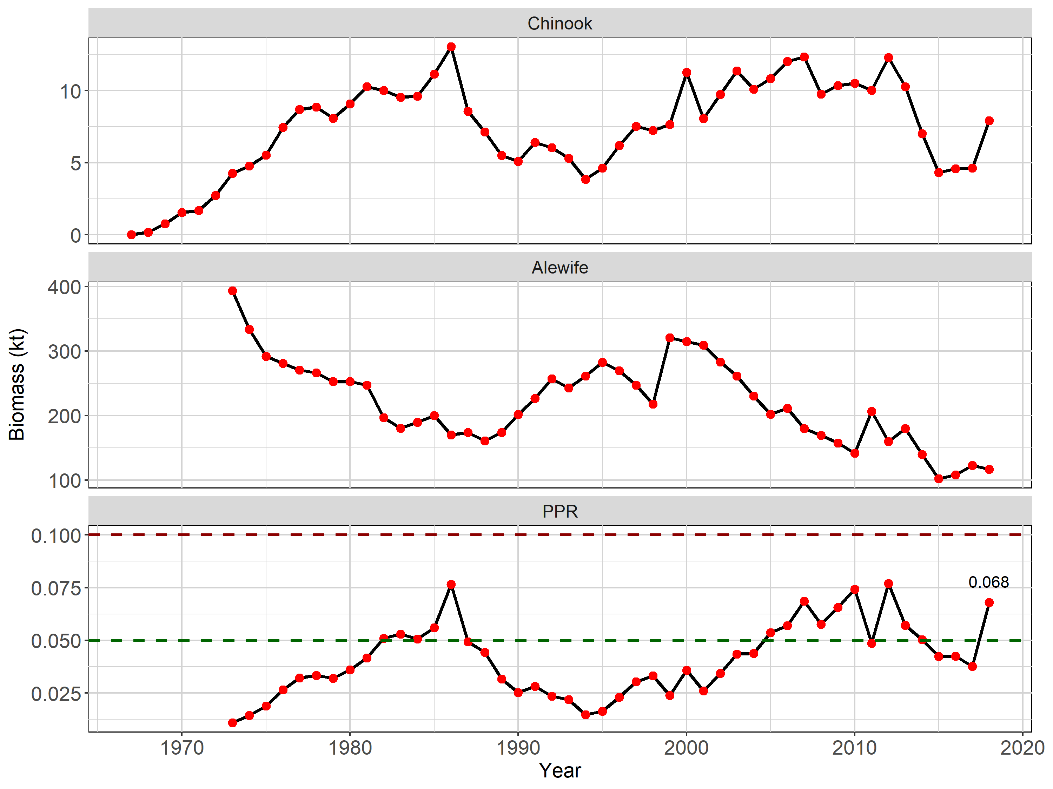
Notes:
Age 1+ Chinook Biomass, age 1+ Alewife Biomass, and the predator Prey Ratio. Subsequent slides explain how we got here.

Slide 3
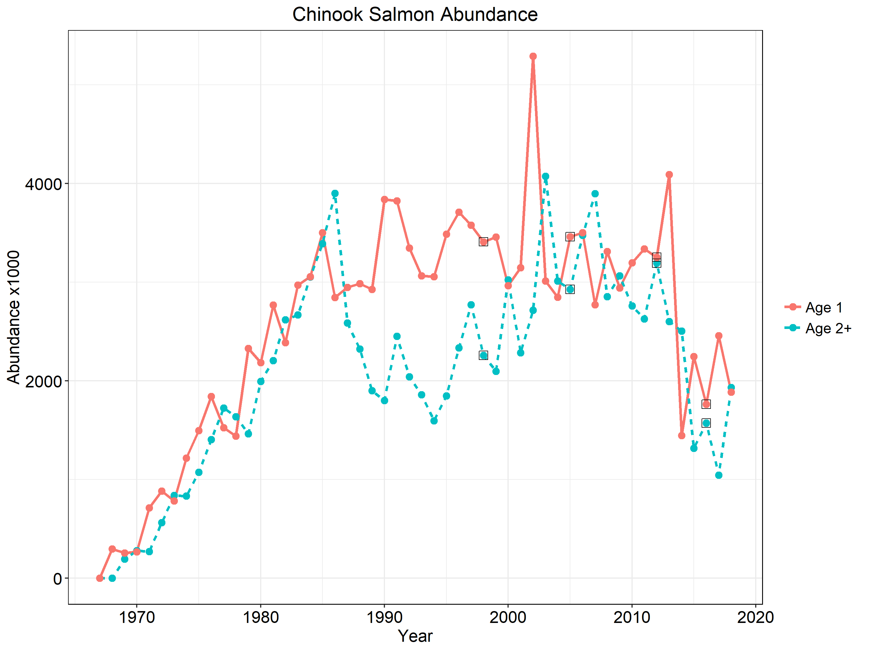
Notes:
Chinook Salmon abundance. Solid red line represents age 1 abundance and hashed blue line represents age 2+ abundance. Black squares mark years where there were stocking reduction decisions.

Slide 4
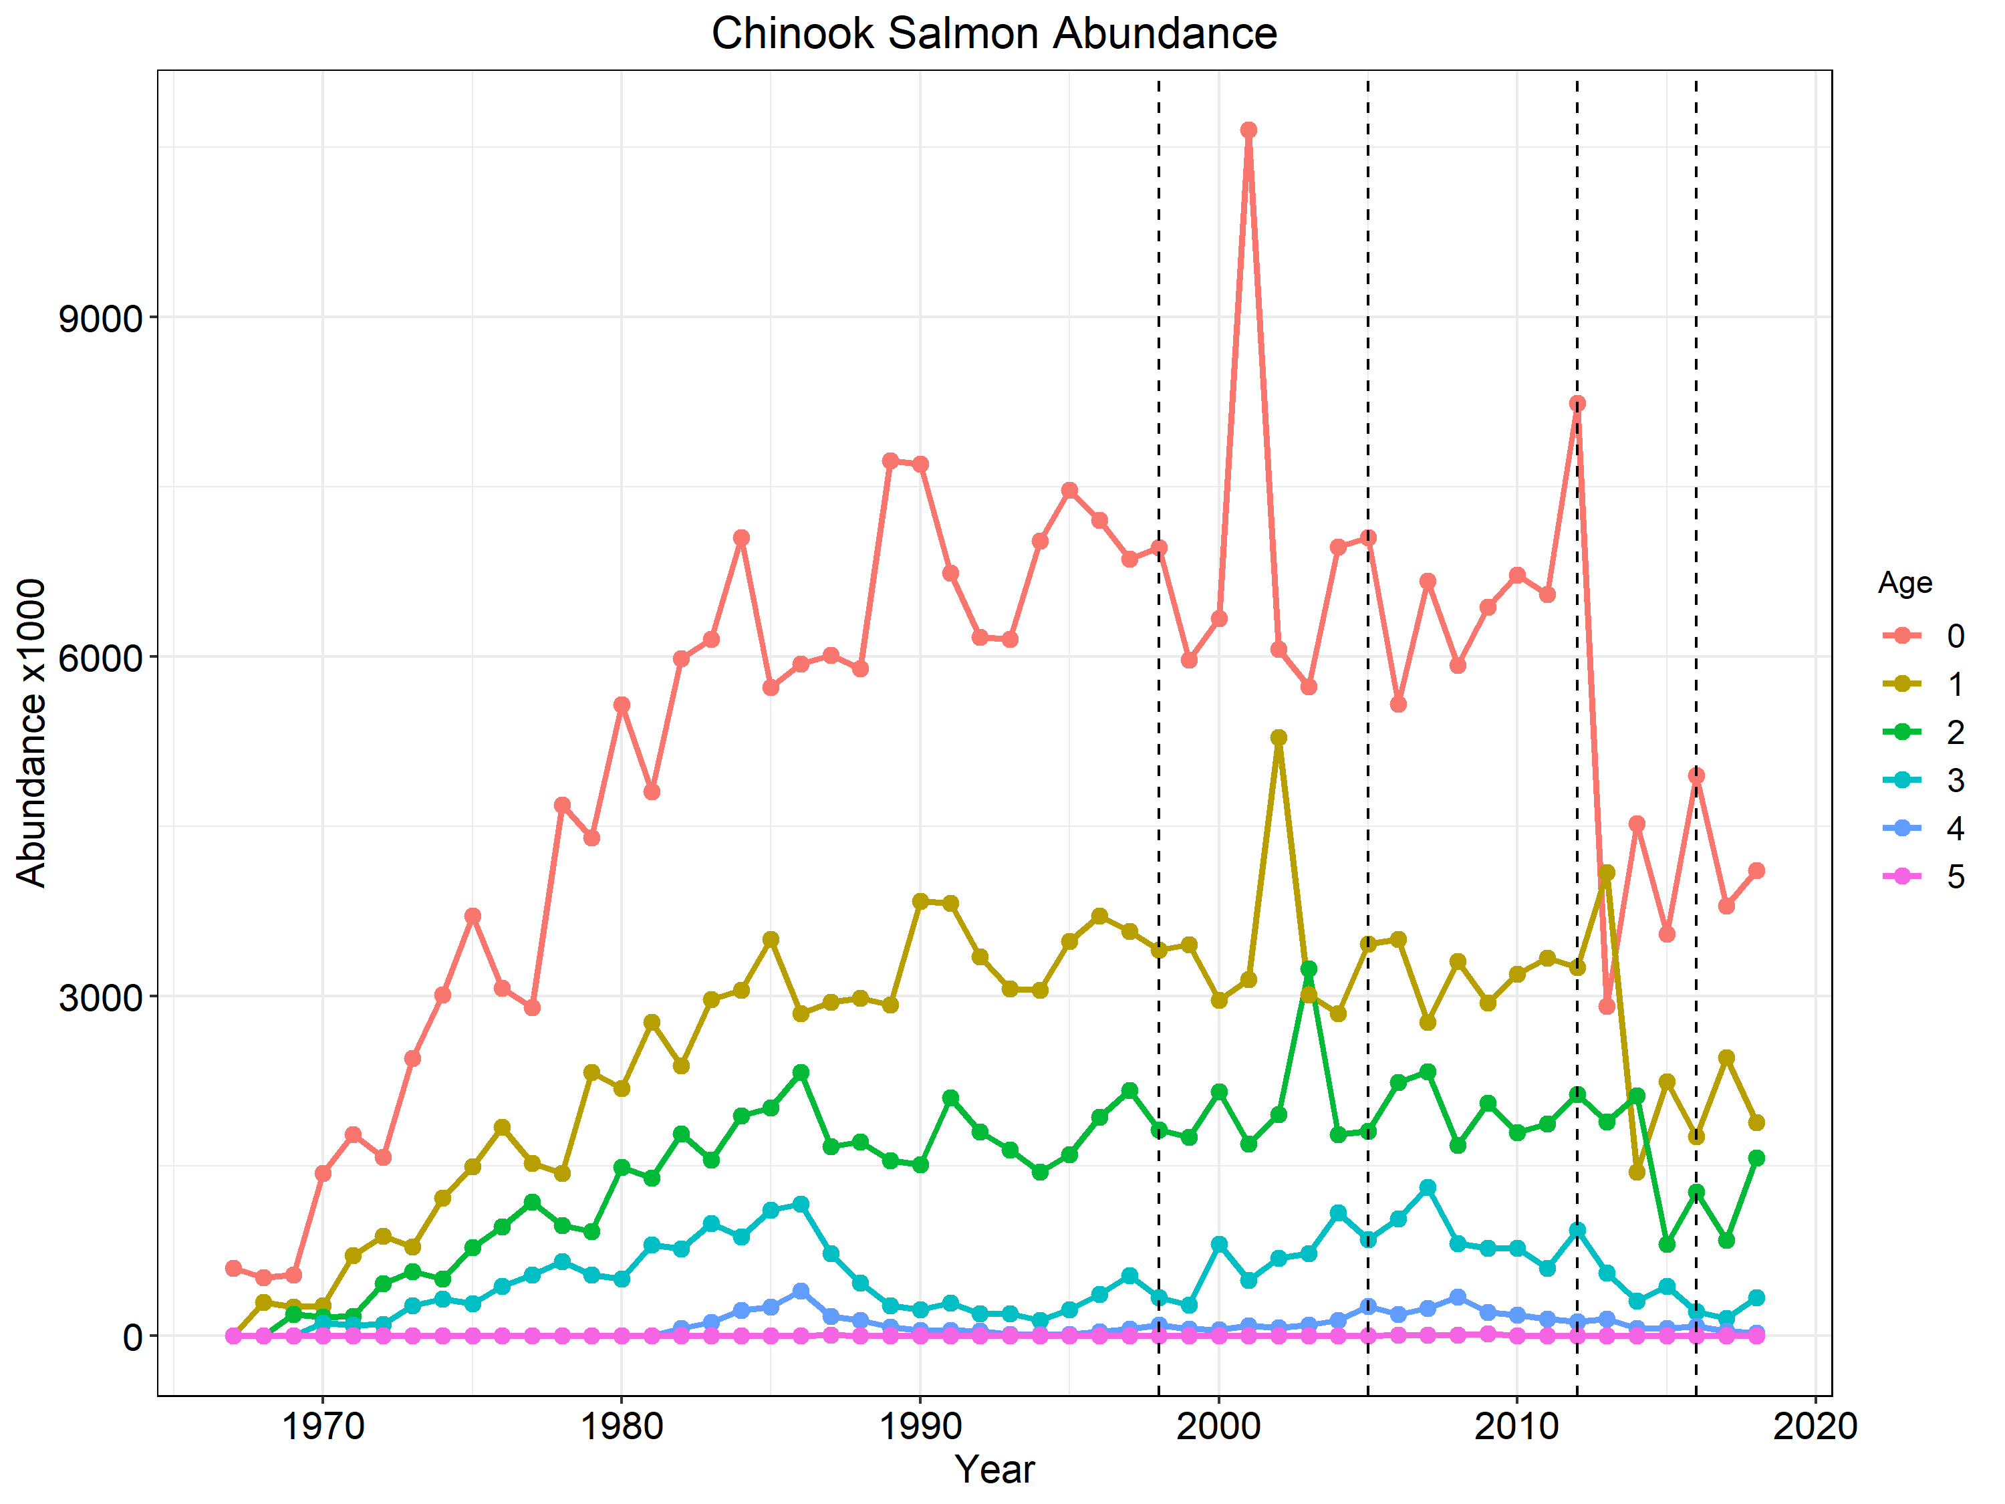
Notes:
Chinook salmon abundance by age with vertical hashed lines representing stocking reduction decision years. You can track cohorts in this figure. For instance, the 2001 and 2012 year class appear to be pretty good and you can see those fish moving through each of the age classes. 2016 appears to have been another good year class for wild recruitment and we are seeing those fish as 2 year old fish in 2018.

Slide 5
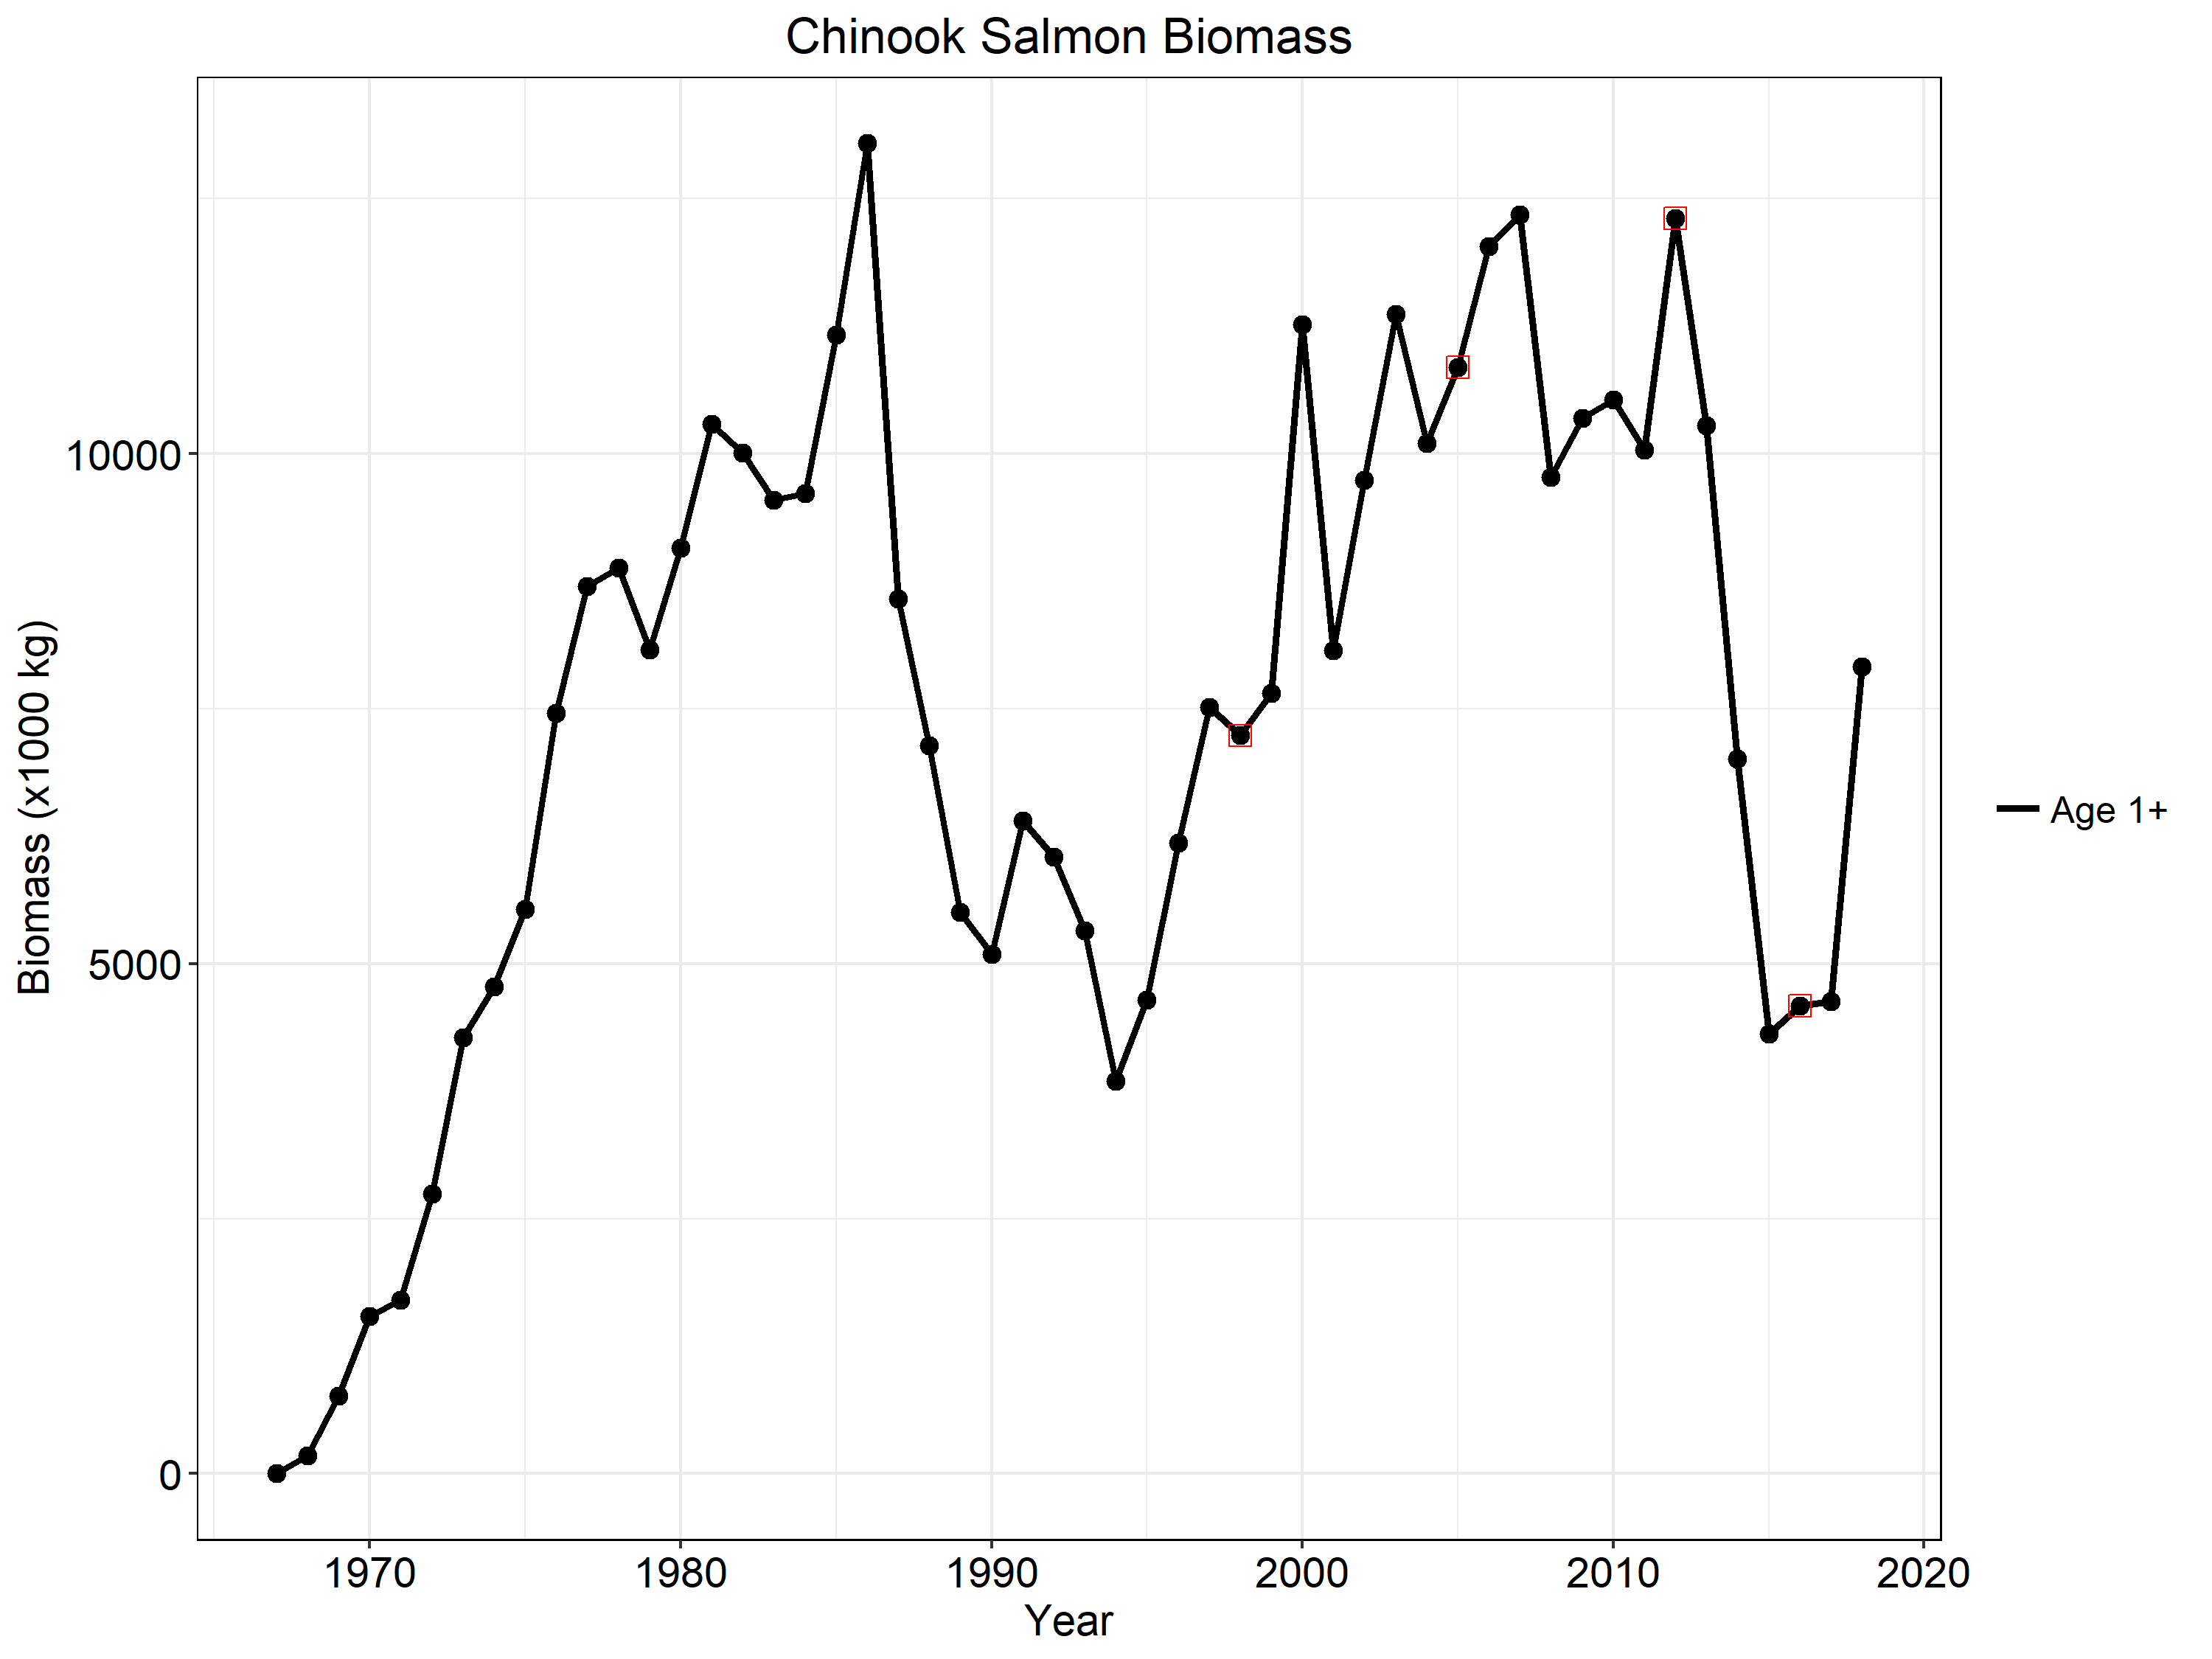
Notes:
Chinook Salmon biomass with red squares indicating stocking reduction decision years. Note the increase at the end of the time series which driven largely by increased weight at age.

Slide 6
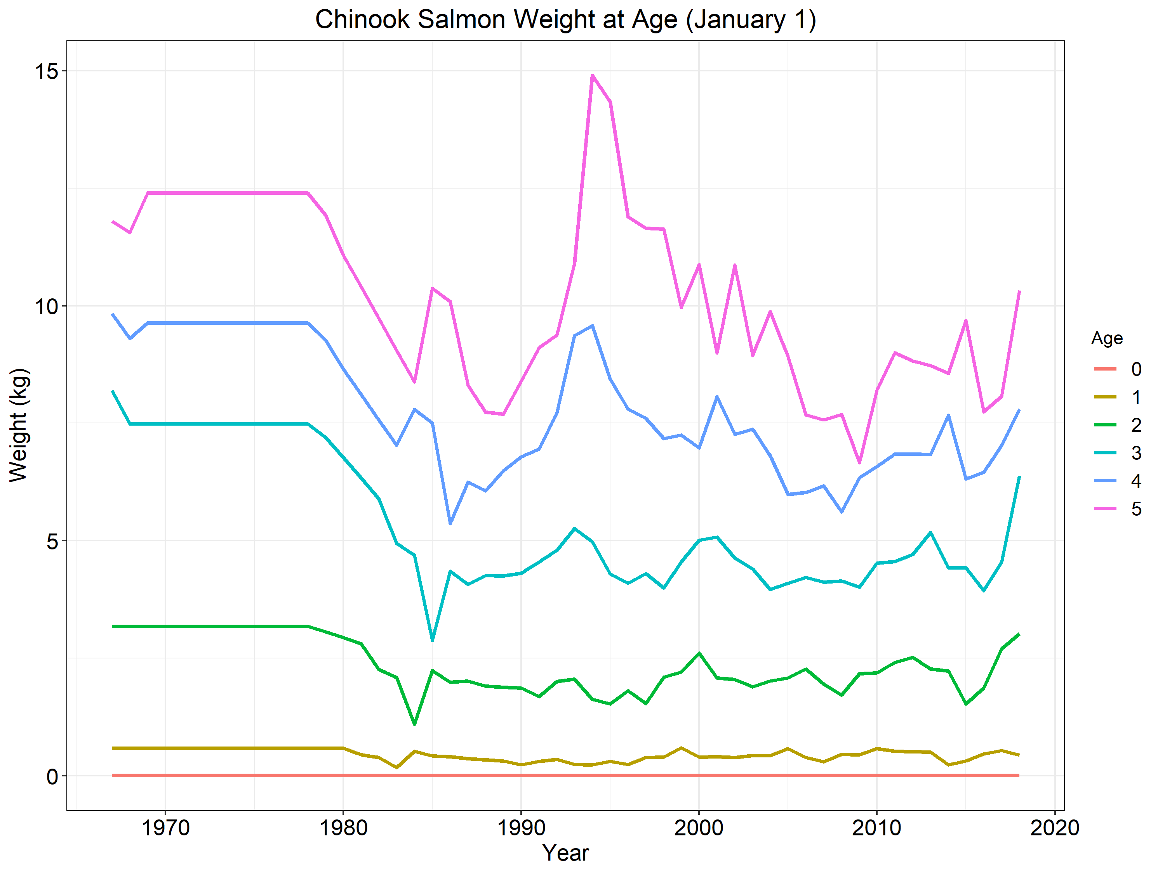
Notes:
Chinook Salmon weight at age on January 1st. Note the substantial increases for age 2+ fish in recent years. Also, keep in mind that age 4-5 fish are exceedingly rare most years (see slide 4) and so most fish caught by anglers are age 2 or 3 and these fish are the largest than we have seen since the 1970s!

Slide 7
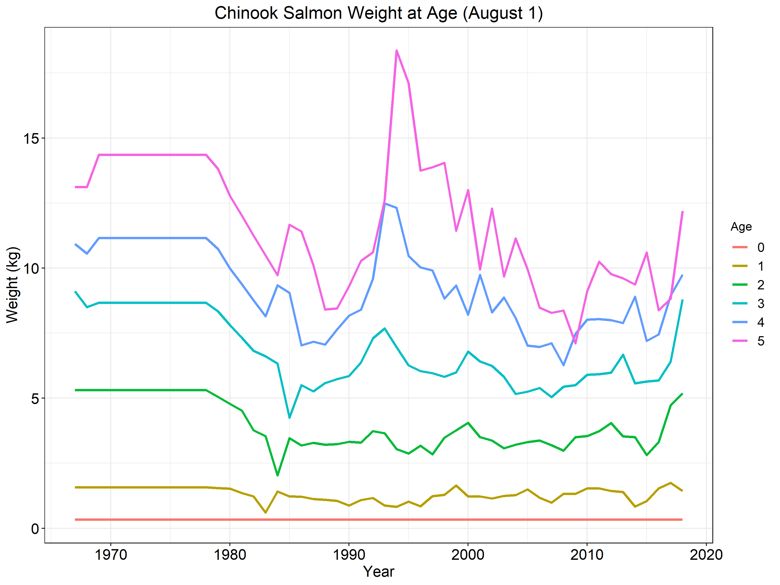
Notes:
Same as the previous slide except that this is weight at age on August 1st instead of January 1st.

Slide 8
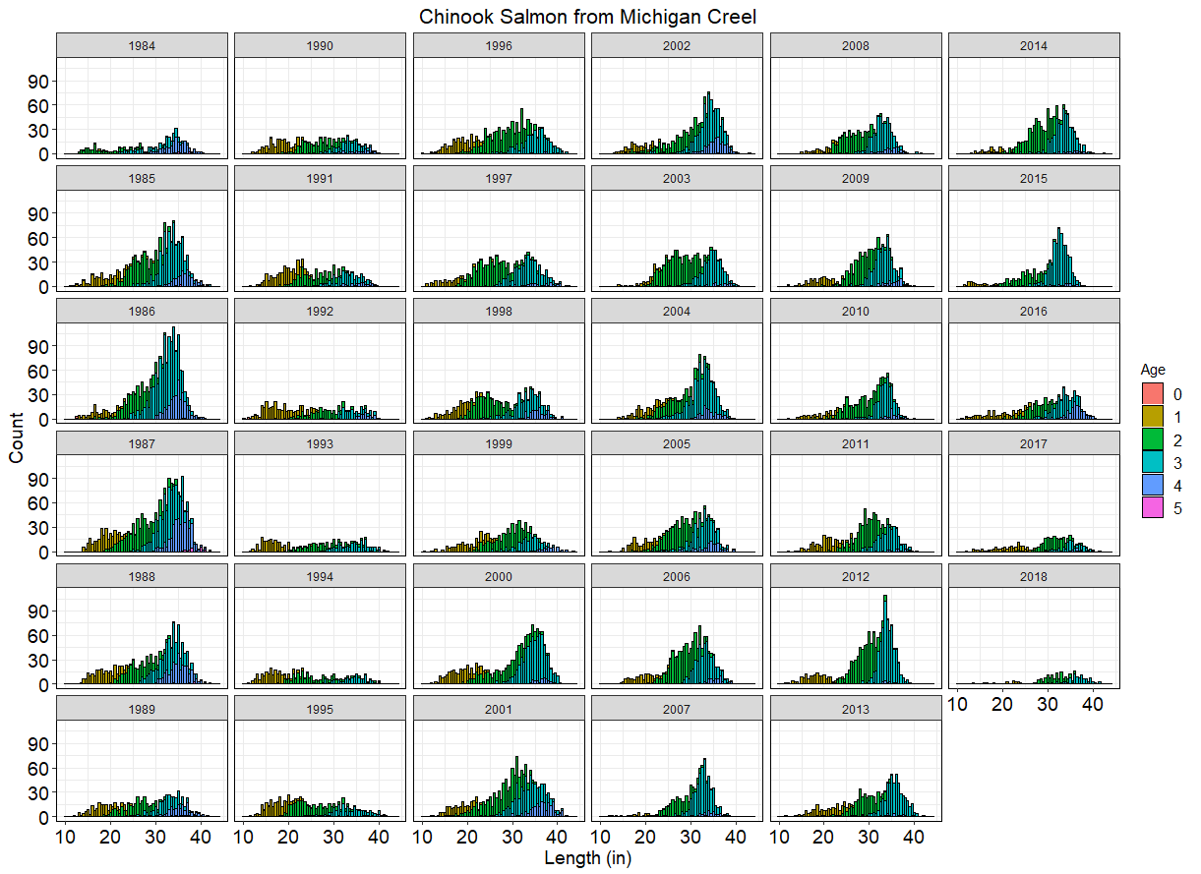
Notes:
This is a side bar slide showing length frequency of Chinook Salmon from MDNR creel with colors demarcating age. Although this isn’t particularly relevant to the 2018 PPR, it is worth noting that it is NOT possible to look at the size of a Chinook salmon and determine its age. Larger size fish in 2018 do not necessarily mean that more age 4 fish were caught but more likely that weight at age has increased markedly for age 2+ Chinook.

Slide 9
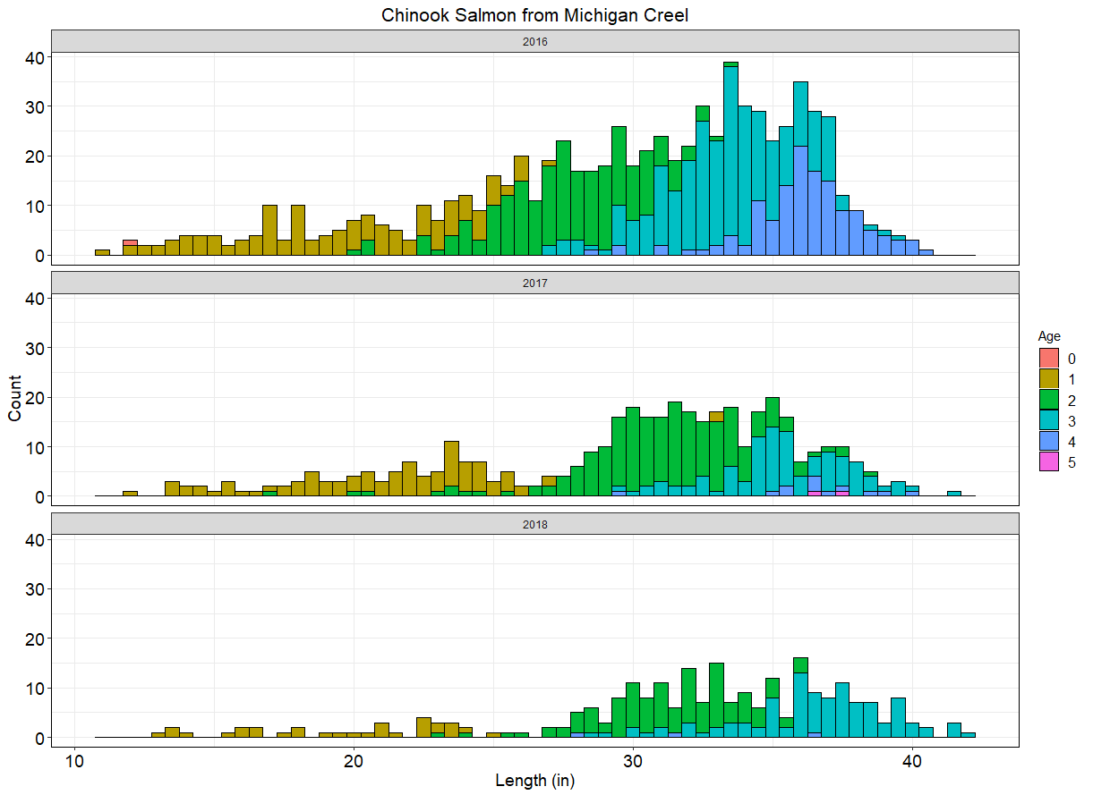
Notes:
Same as the slide before but highlighting only the last 3 years.

Slide 10
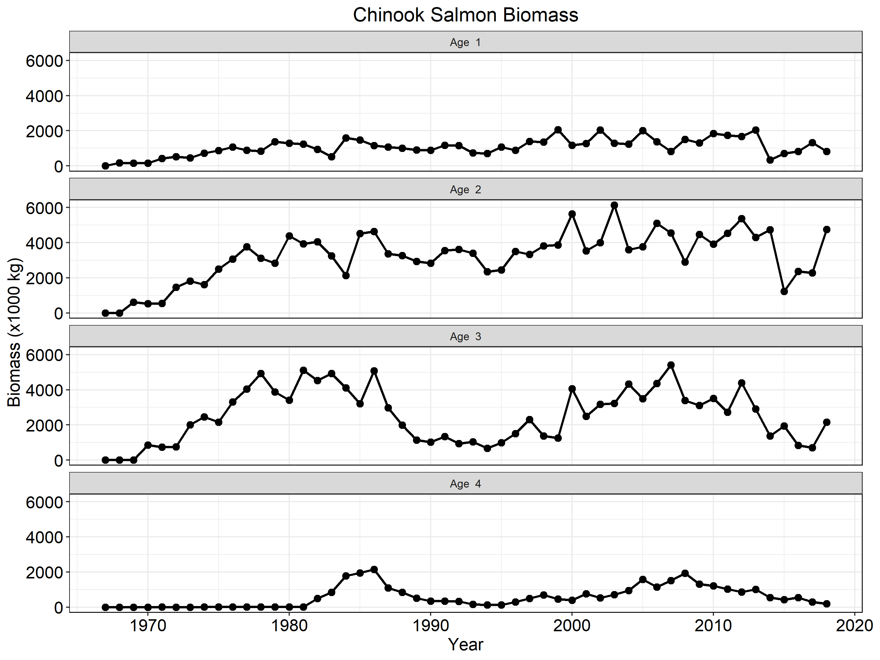
Notes:
Chinook Salmon biomass broken down by age. Using this figure, we can see that the increase in biomass in the last year of the time series corresponds to much higher biomass of age 2 fish and a moderate increase in age 3 biomass driven largely by greater weight at age for these fish.

Slide 11
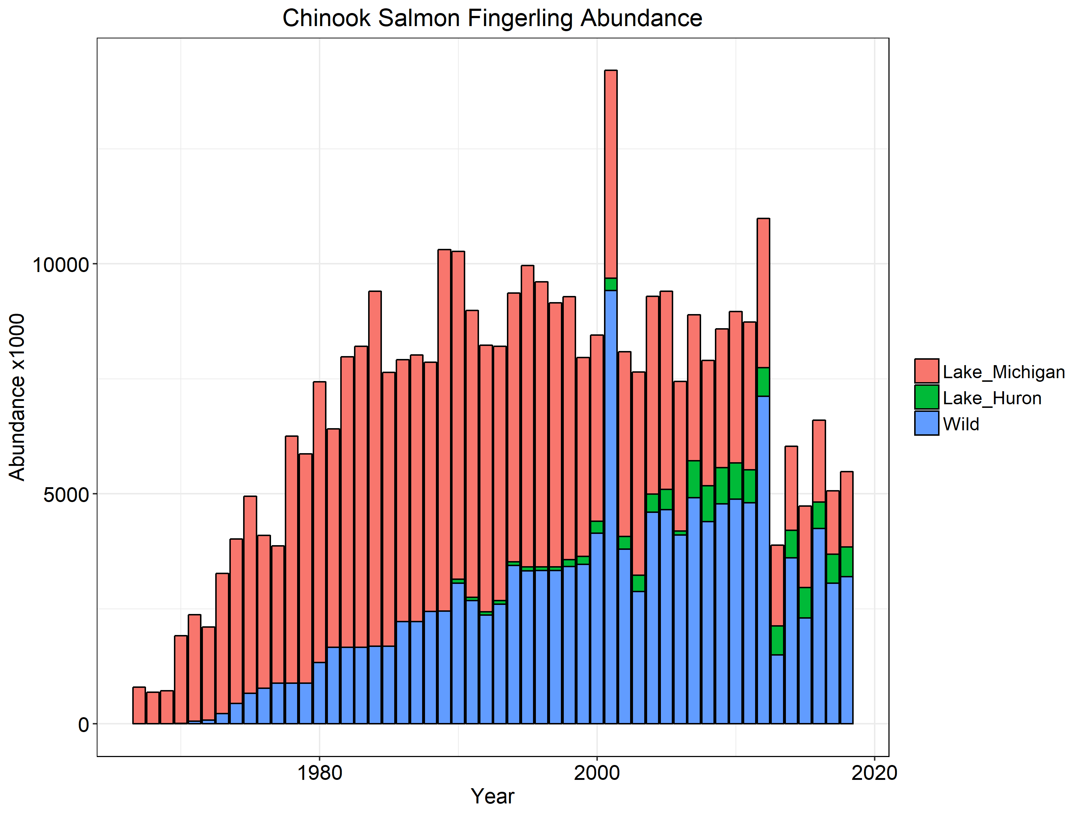
Notes:
Chinook salmon fingerling abundance. We appear to be in a new regime of Chinook abundance since the 2013 stocking reduction although wild recruitment is variable.

Slide 12
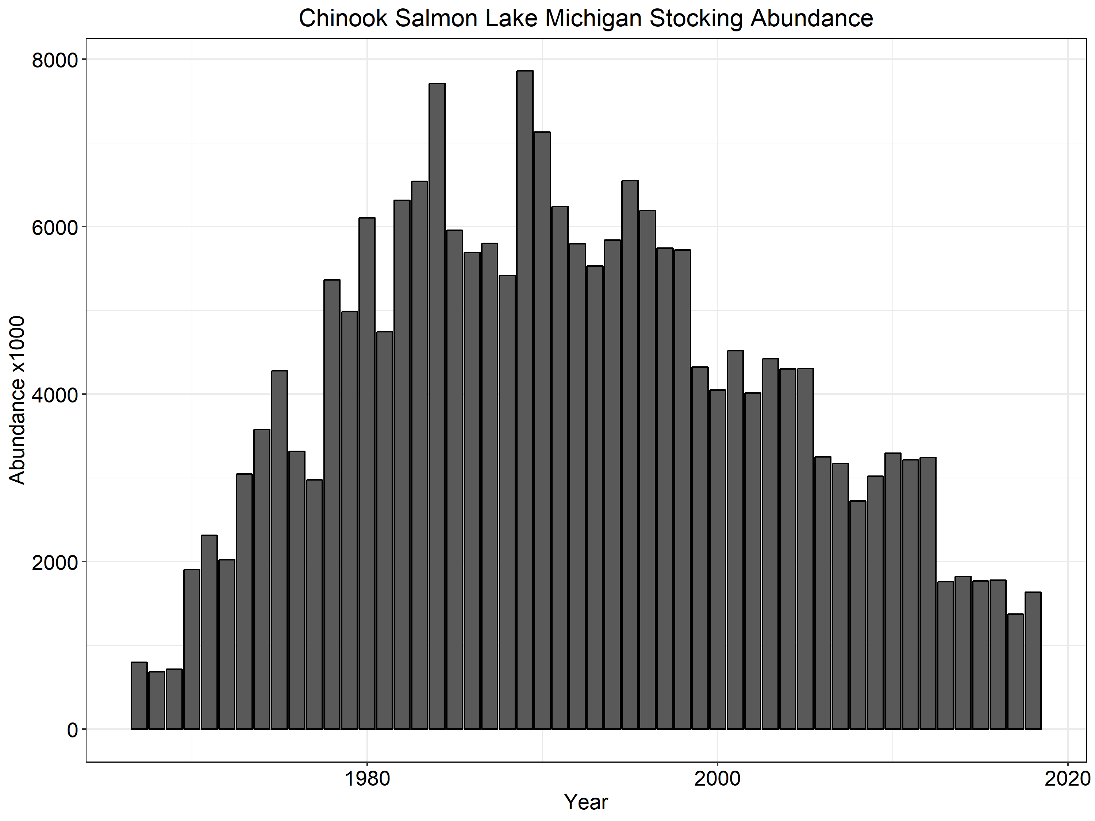
Notes:
Chinook stocking numbers.

Slide 13
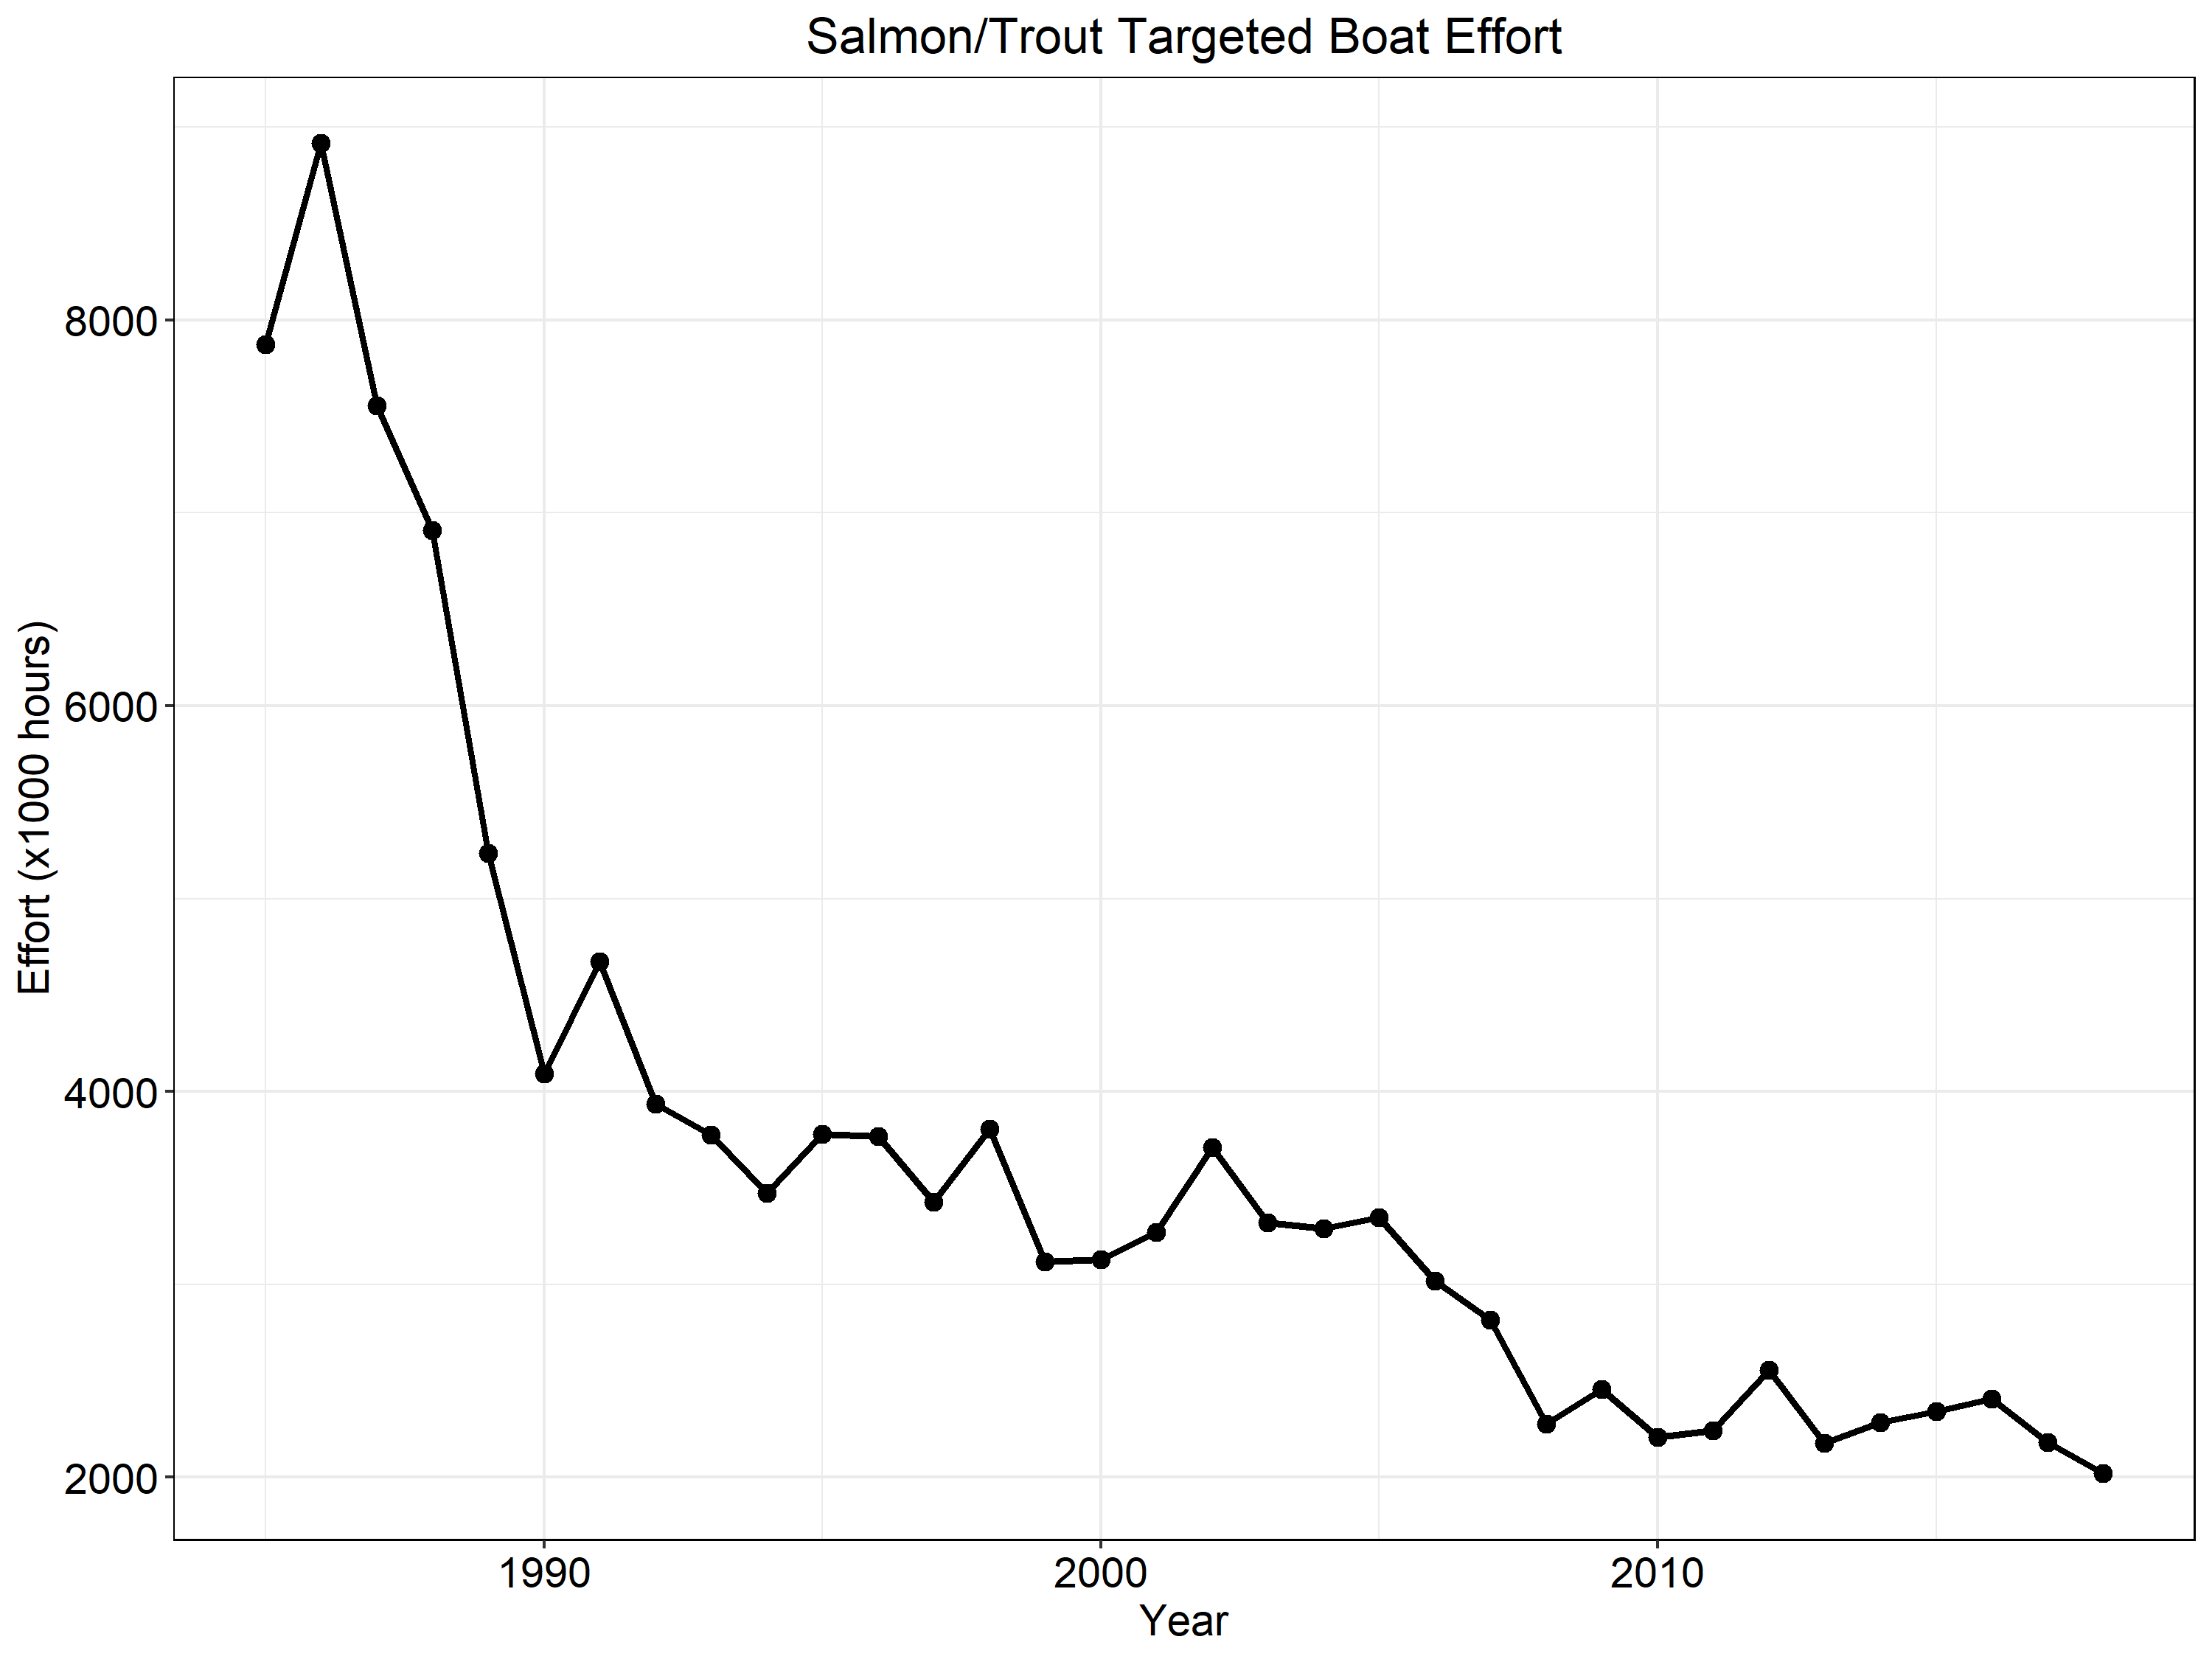
Notes:
Targeted salmon and trout boat fishing effort.

Slide 14
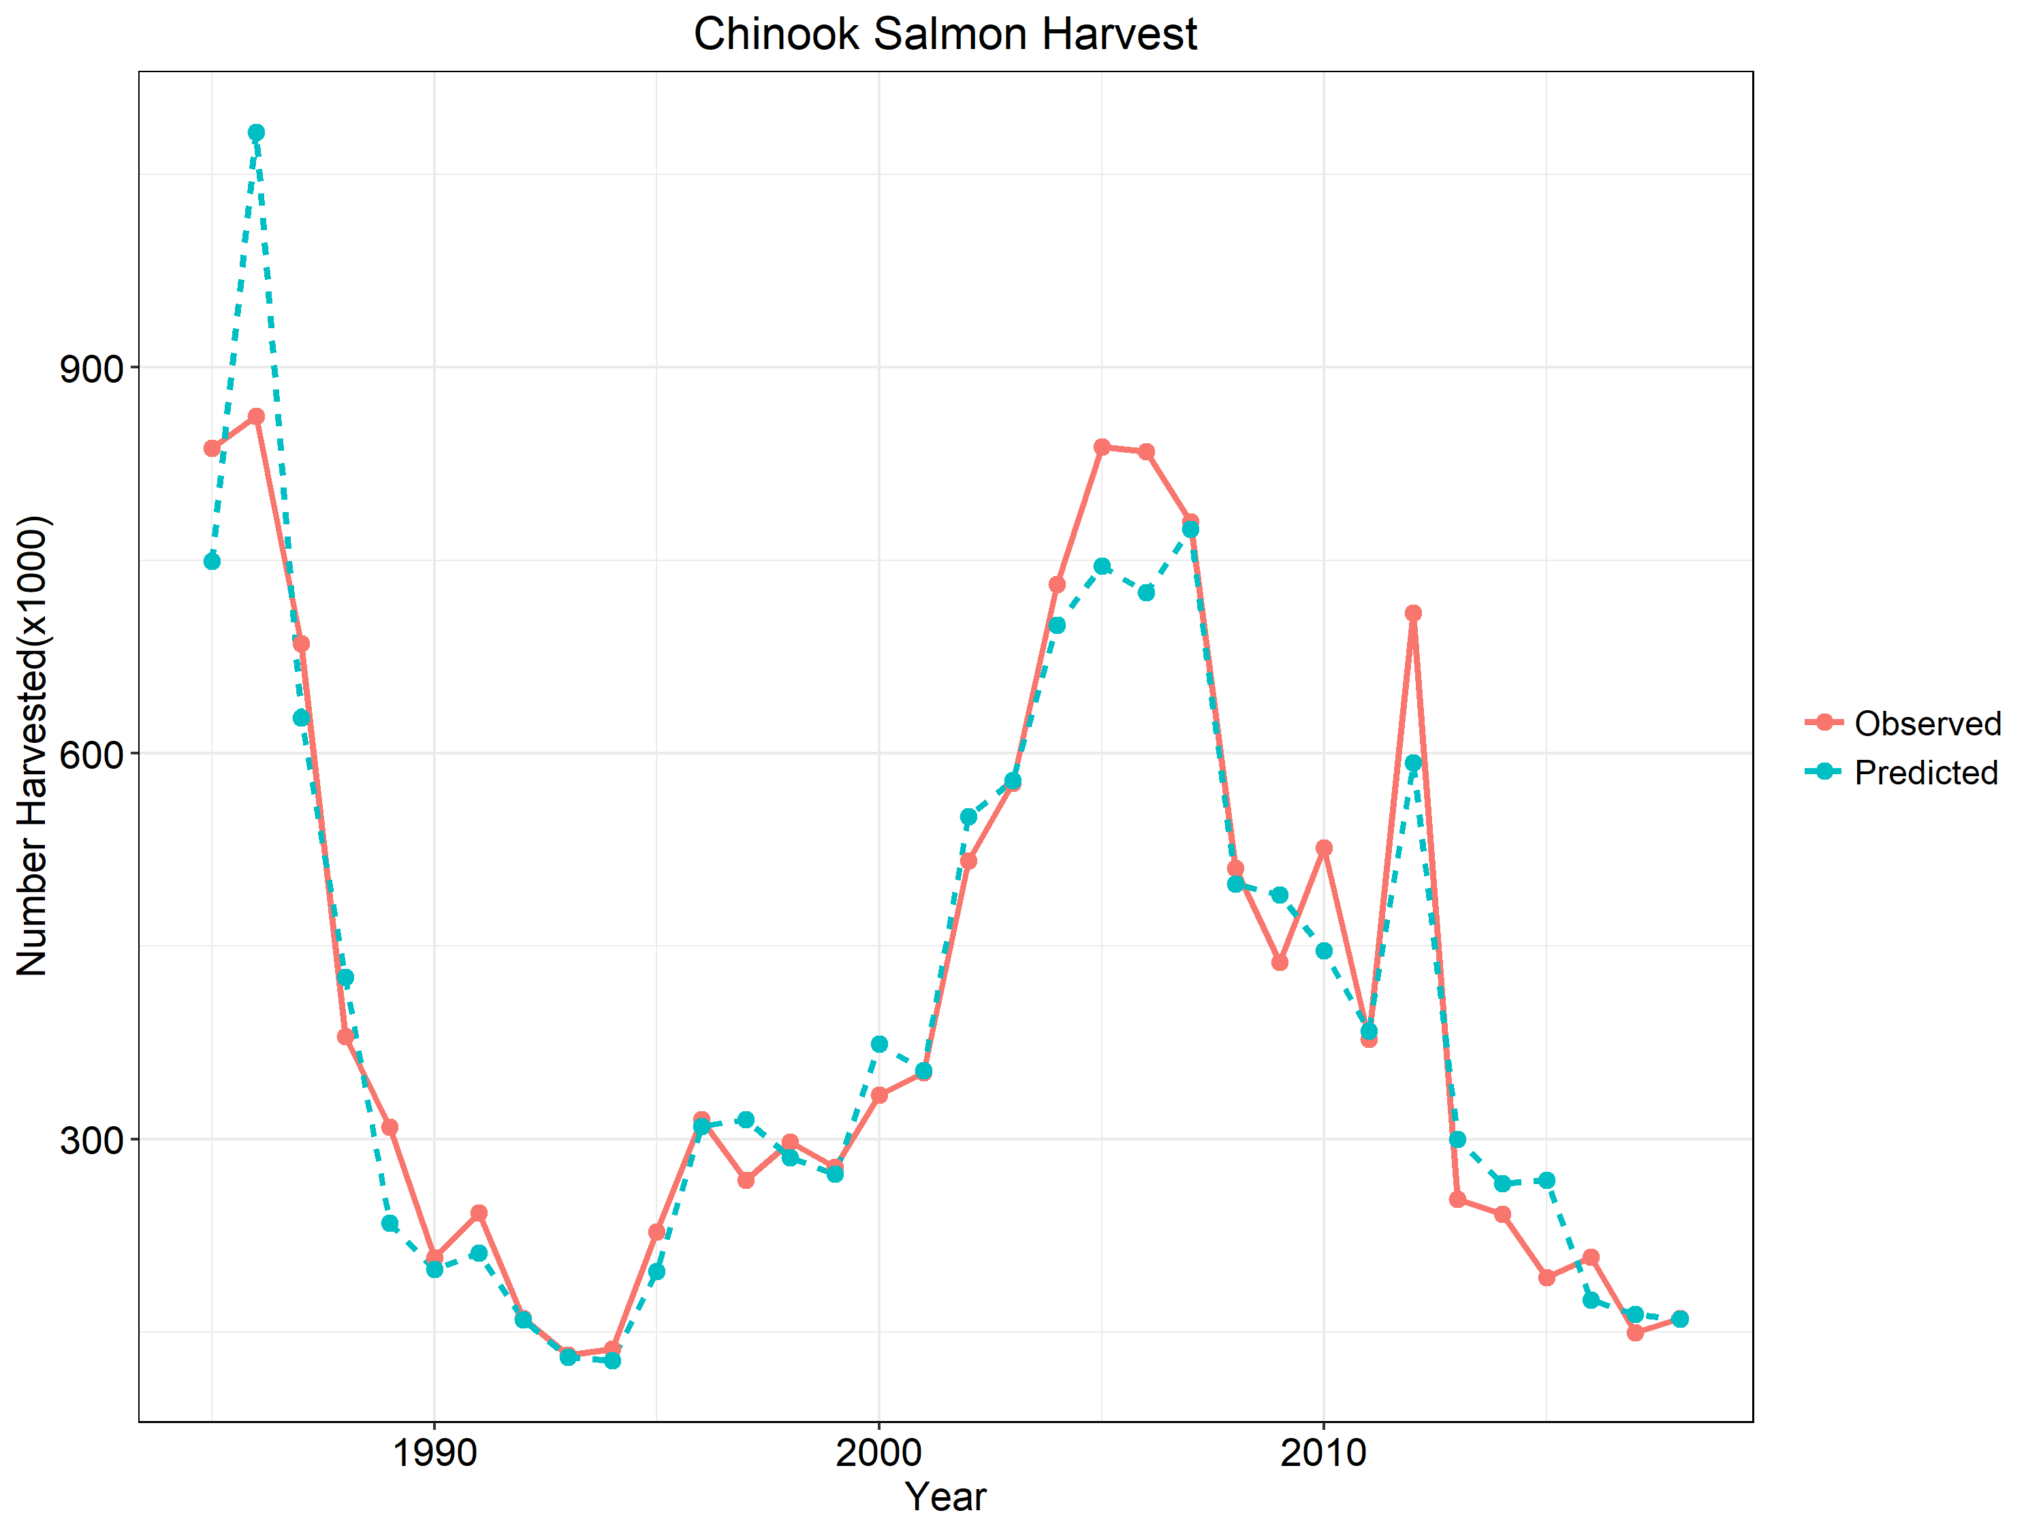
Notes:
Chinook Salmon harvest. Solid line is the observed values and the hashed line is model predicted harvest. As you can see the model does a nice job fitting harvest data and there has be a decreasing trend corresponding to reduced effort (prior slide).

Slide 15
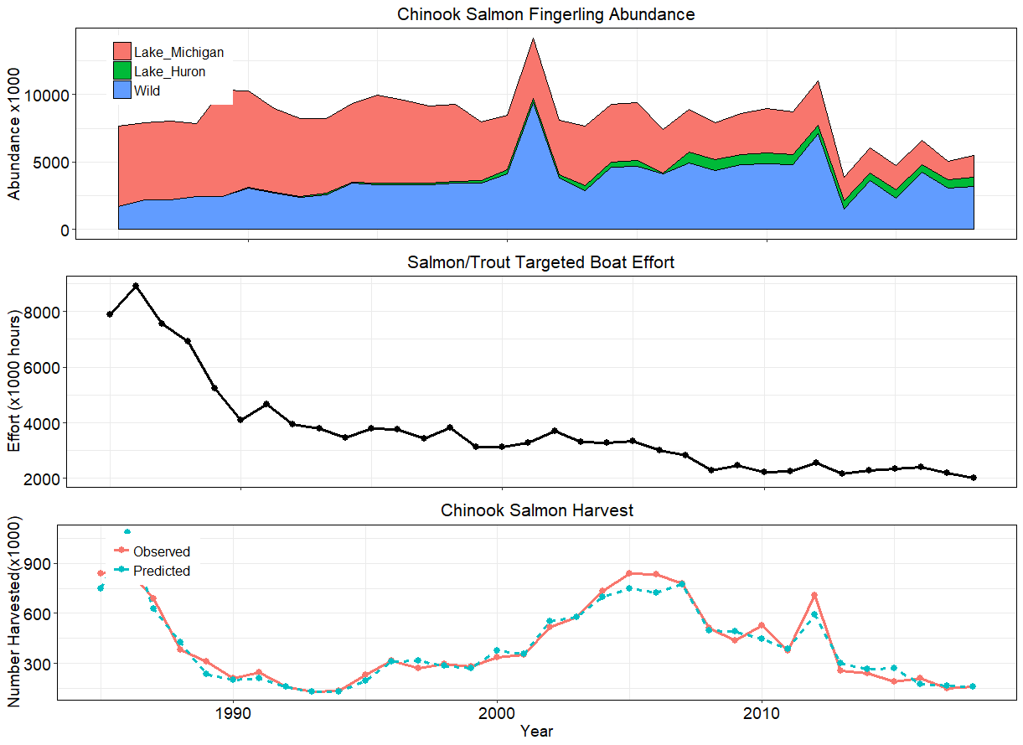
Notes:
Panel Plot combining Chinook fingerling abundance, targeted boat effort and Chinook harvest.

Slide 16
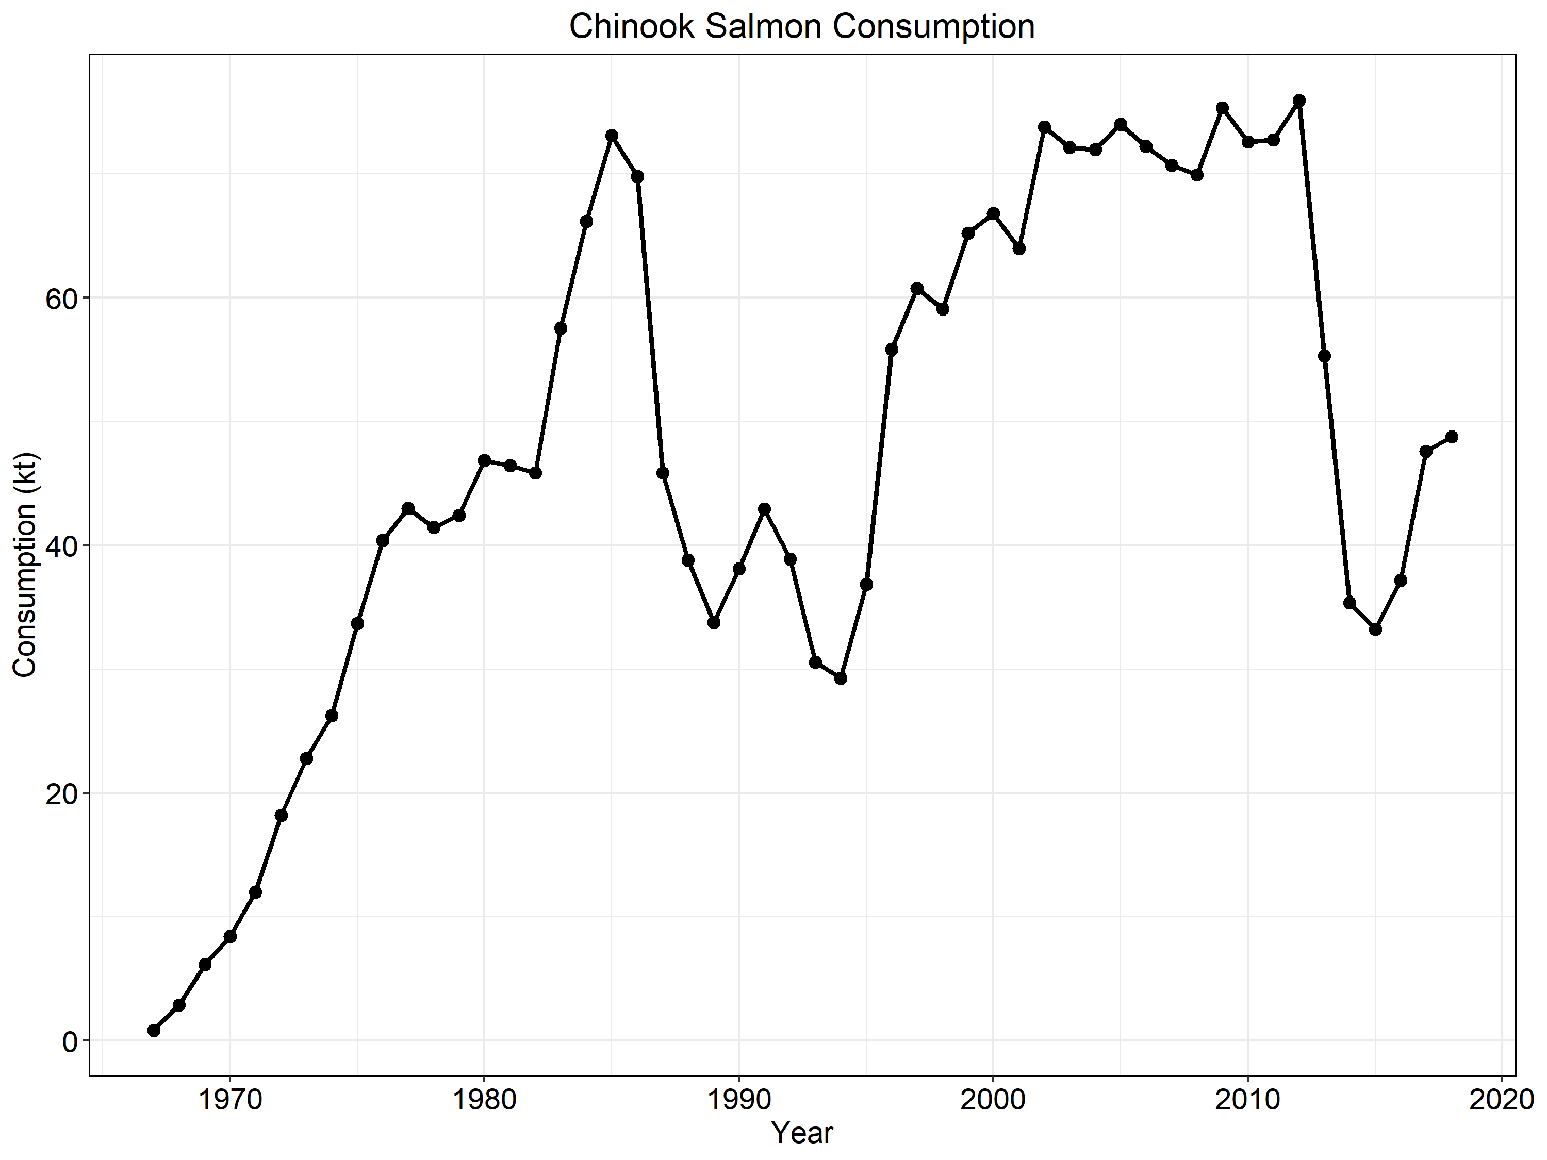
Notes:
Total Chinook Salmon consumption. Note the upward trend the last few years which corresponds to increasing growth rates and weight at age.

Slide 17
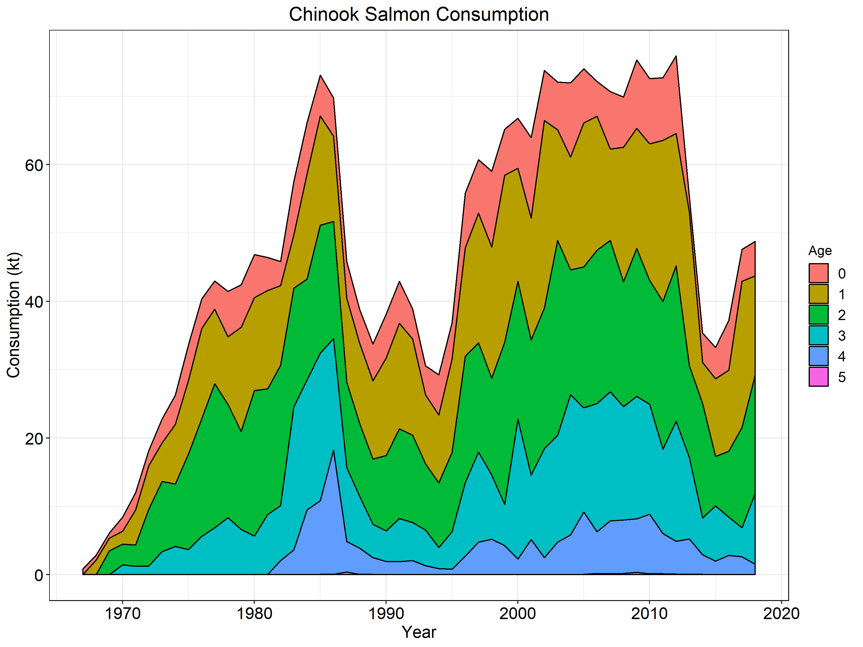
Notes:
Same as the previous slide but broken down by age class.

Slide 18
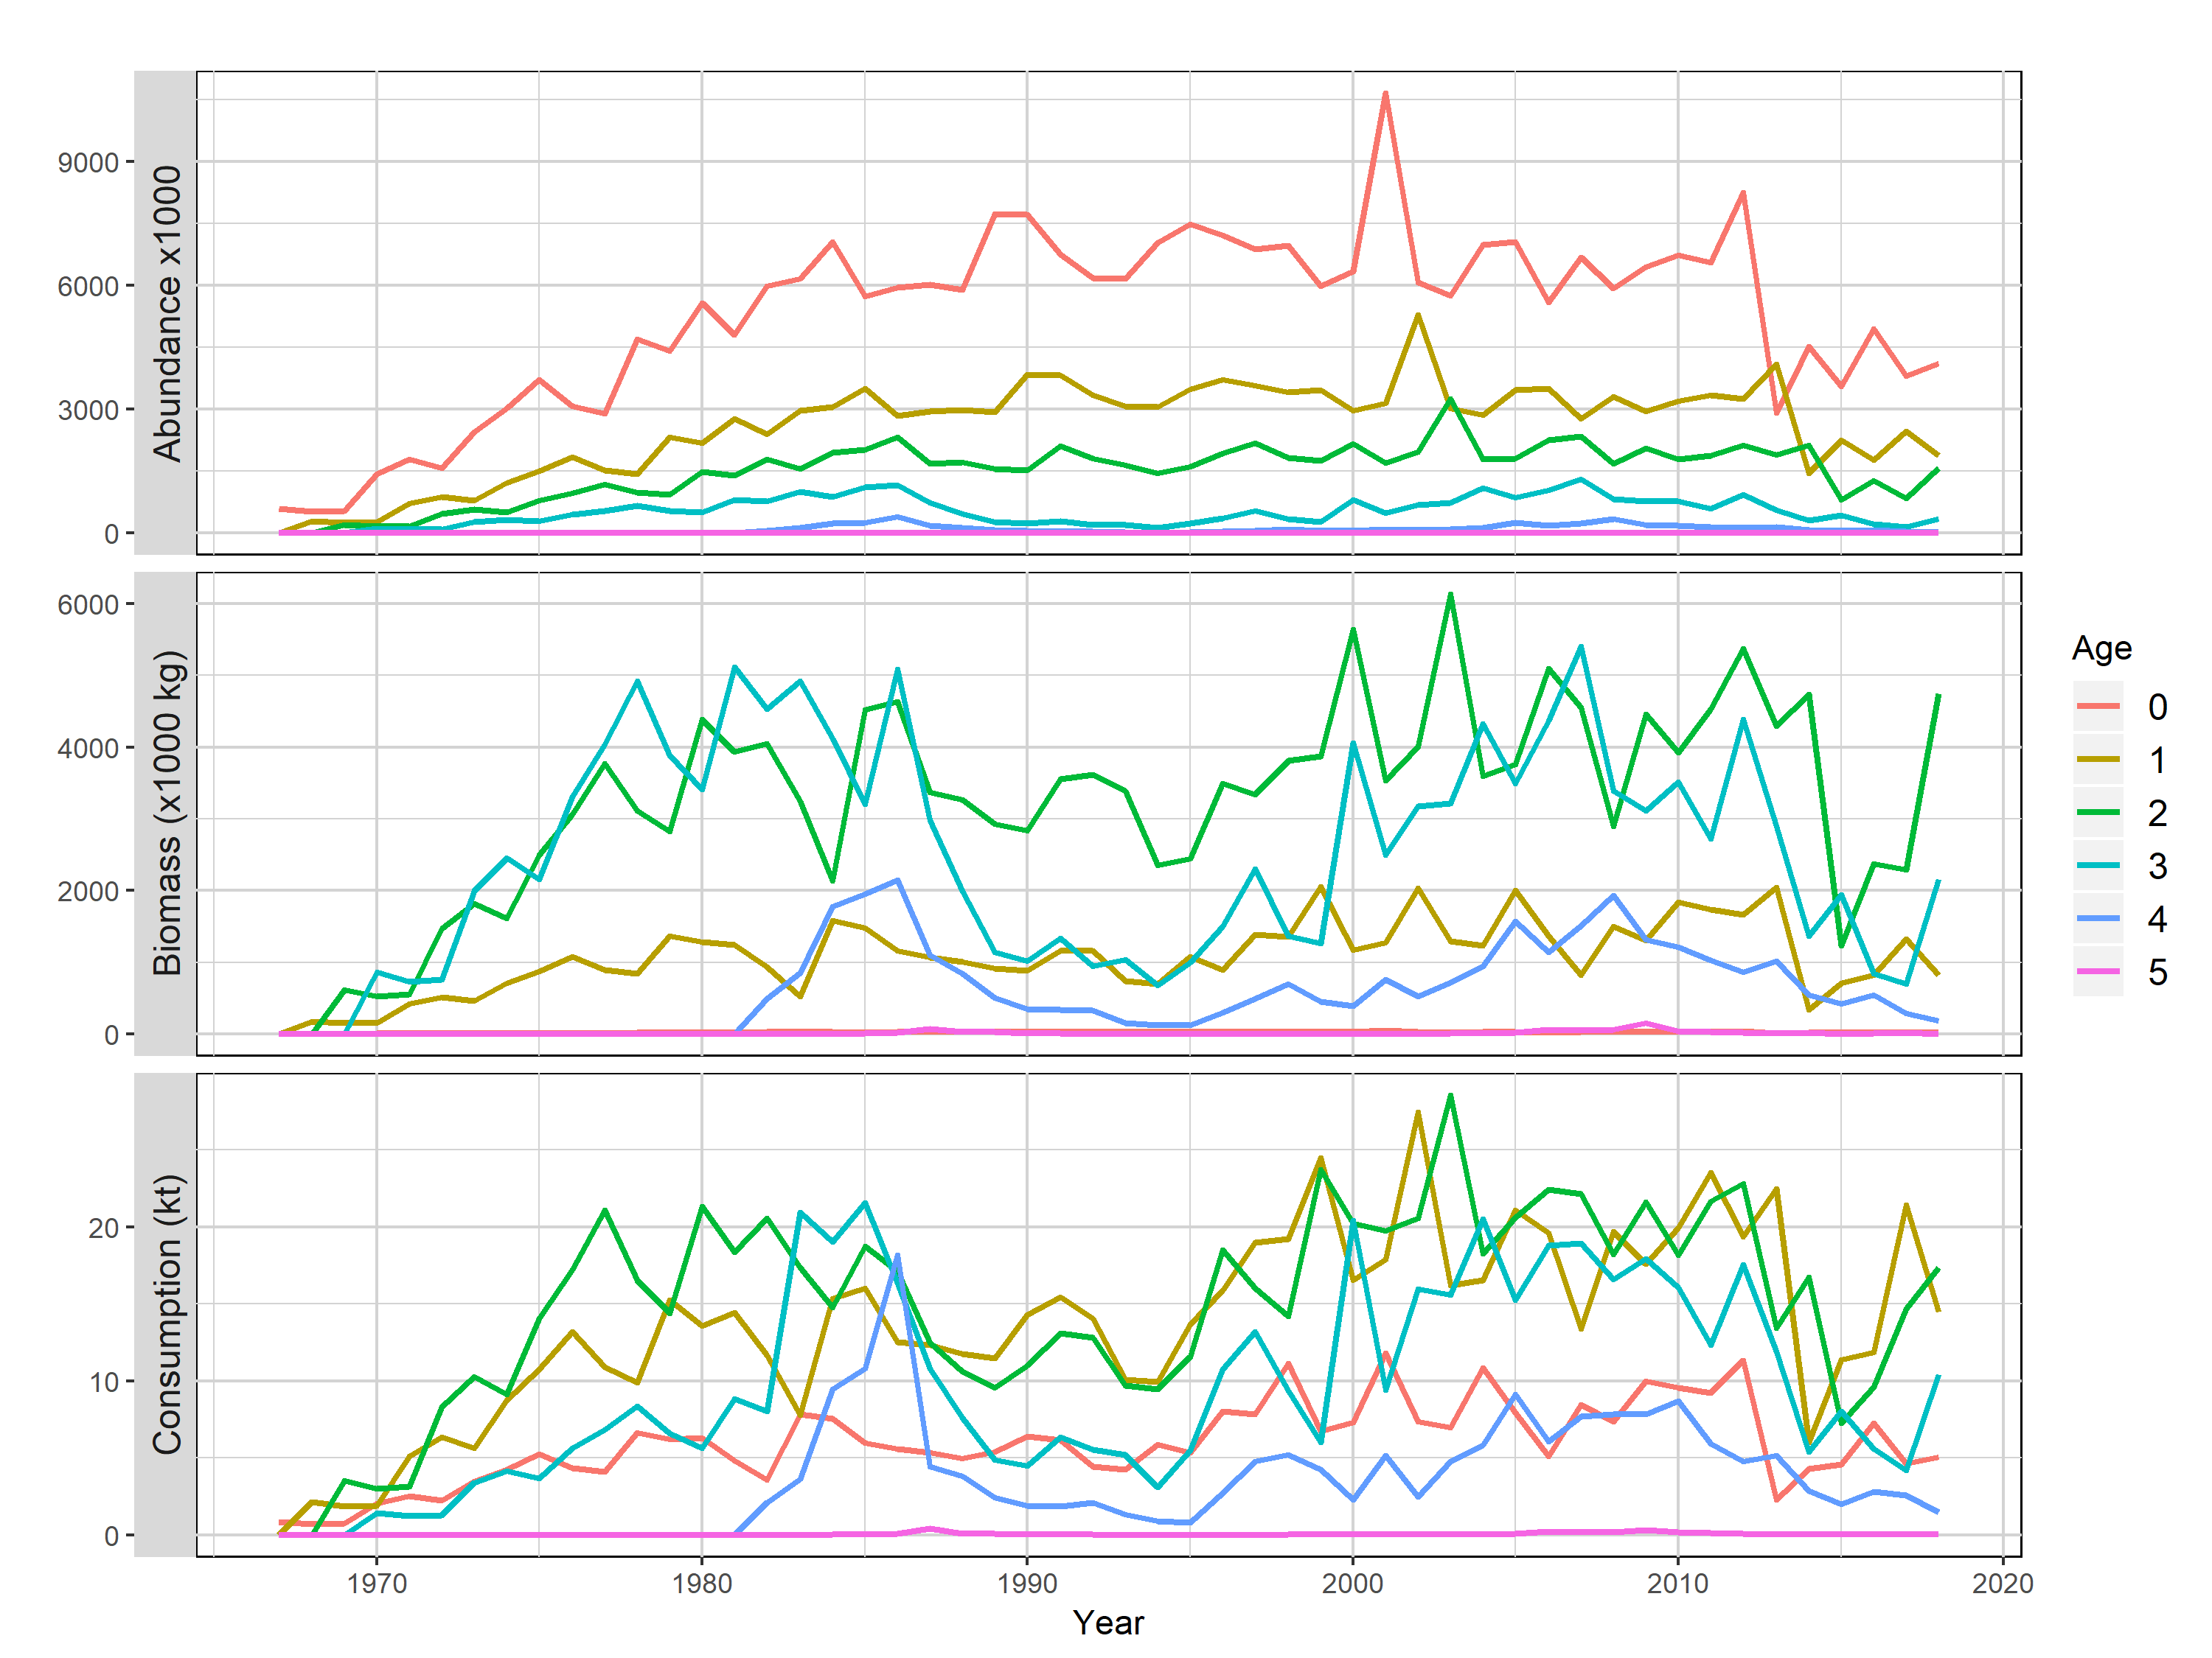
Notes:
Panel plot depicting the relationship between abundance, biomass, and consumption for Chinook Salmon. Looking at the last several years, it is apparent that moderate increases in age 2 and 3 abundance coupled with increased weight at age have lead to much greater biomass of age 2 and 3 Chinook in in 2018. Greater biomass and growth rates led to greater total consumption despite a small declines in age 1 consumption in 2018.

Slide 19
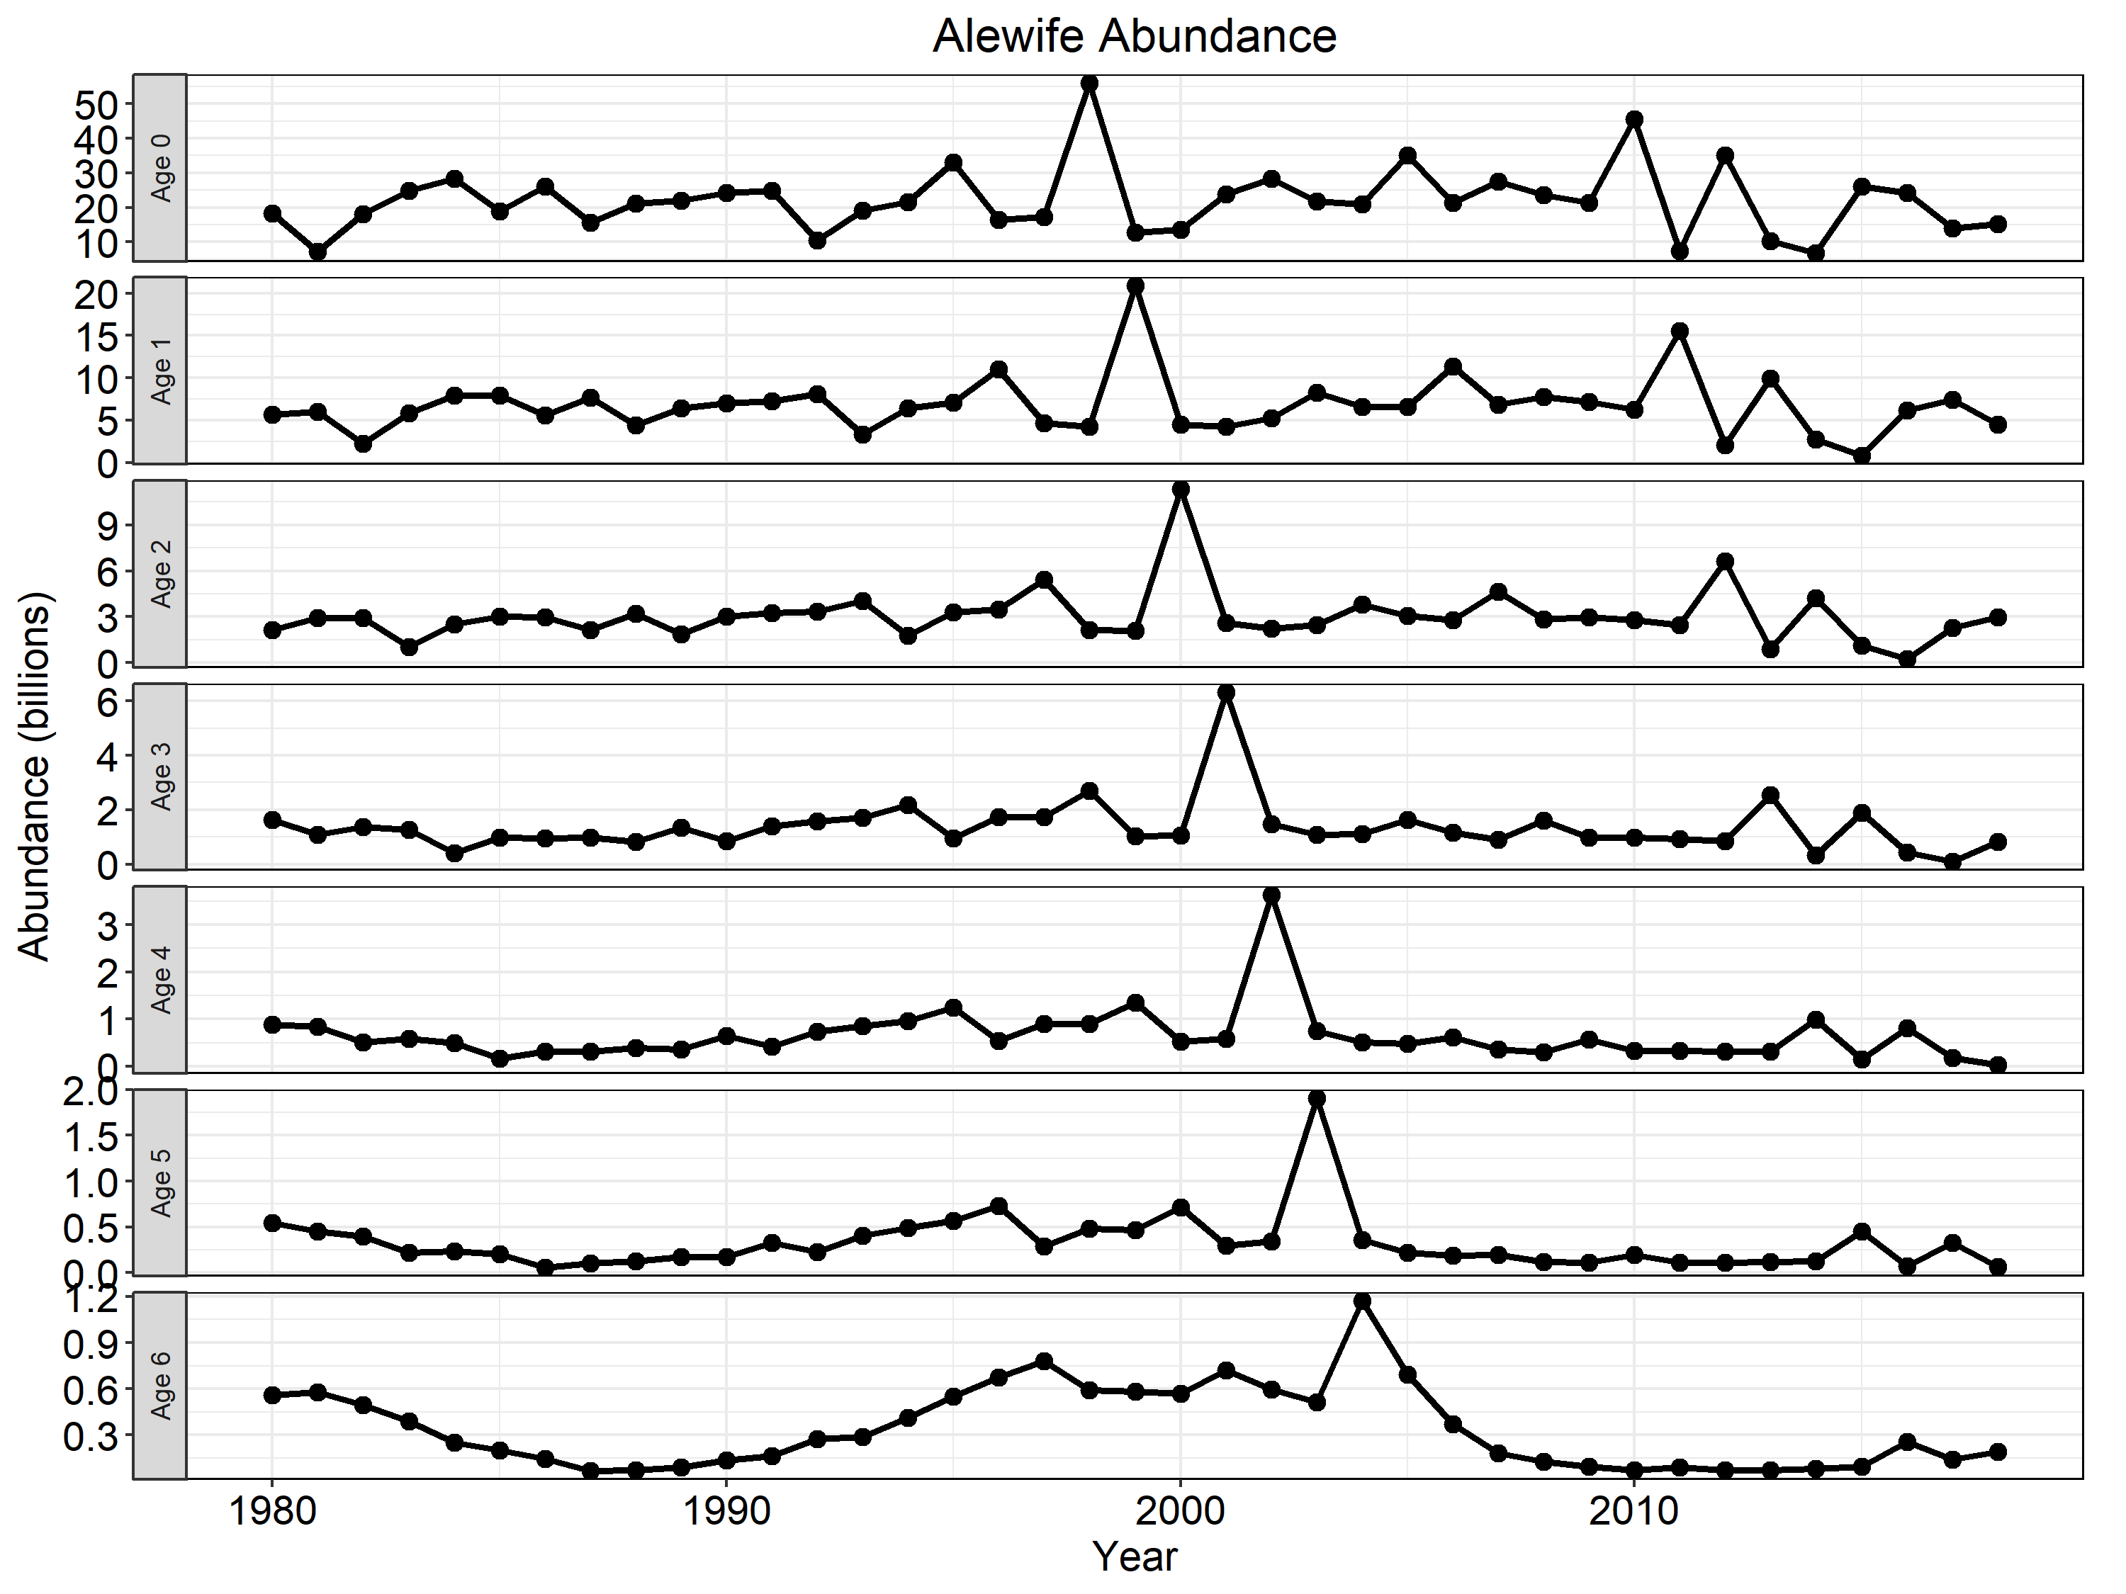
Notes:
Alewife abundance at age. We can track cohorts of alewives through time in this figure. Note the strong 1998, 2010, and 2012 year classes moving through each of the age class panels. However, keep in mind that the y scales vary and there are actually very few fish in the older age classes. Moderate recruitment in 2015 and 2016 appear to be providing most of the current alewife biomass in the lake.

Slide 20
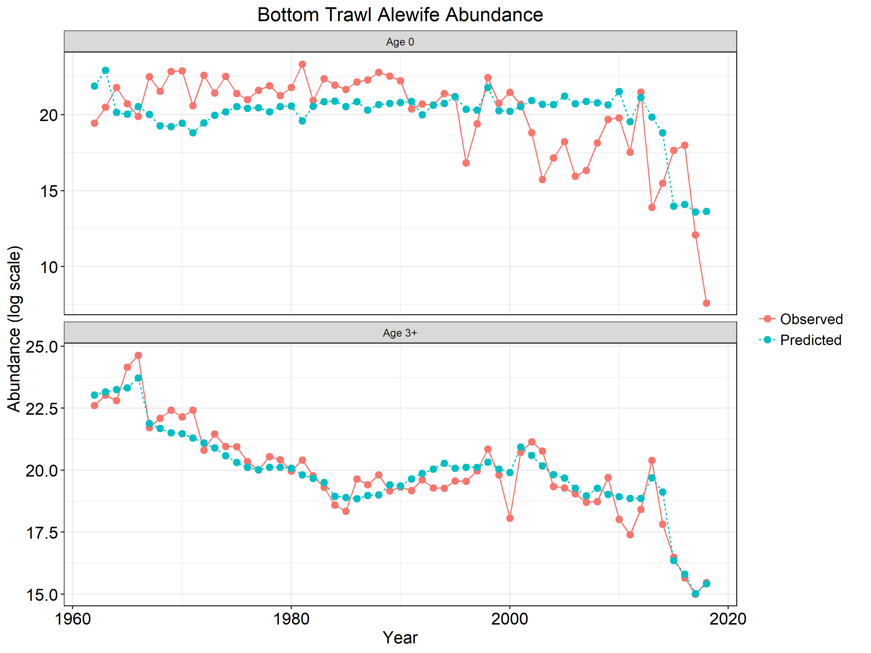
Notes:
Alewife age 0 (top) and age 3+ (bottom) abundance from the bottom trawl. Red solid line represents observed data and blue hashed line represents model fits. Note the log scale. Catchability of bottom trawl was allowed to estimate differently starting in 2015 in because of divergence between estimates of alewife abundance from bottom trawl and hydroacoustic surveys.

Slide 21
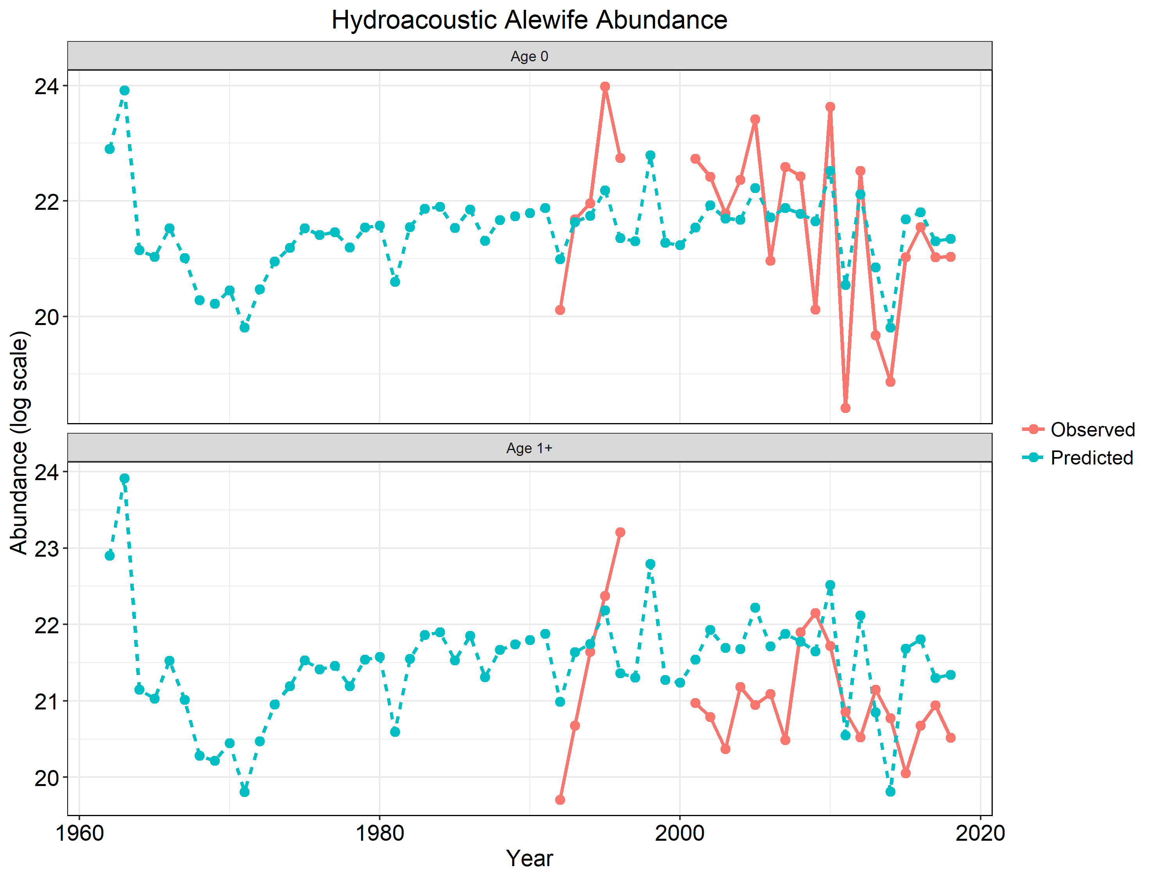
Notes:
Alewife age 0 (top) and age 1+ (bottom) abundance from hydroacoustics. Red solid line represents observed data and blue hashed line represents model fits. Note the log scale.

Slide 22
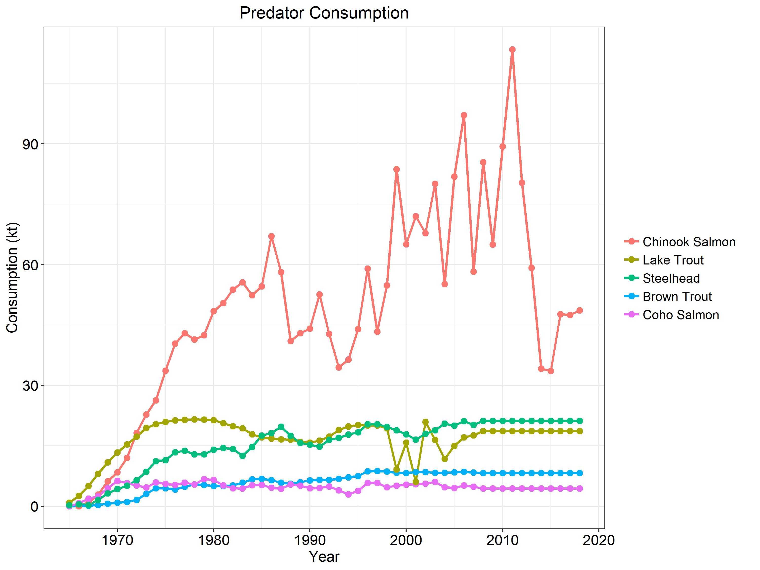
Notes:
Consumption of age 1+ predators.

Slide 23
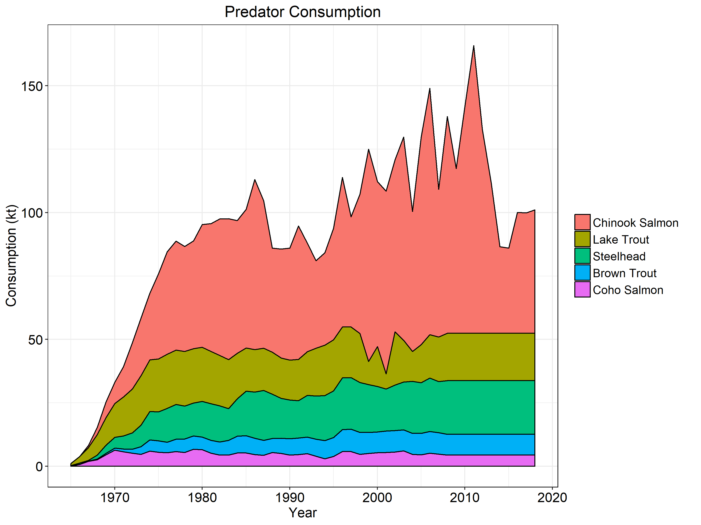
Notes:
Cumulative consumption of age 1+ predators.

Slide 24
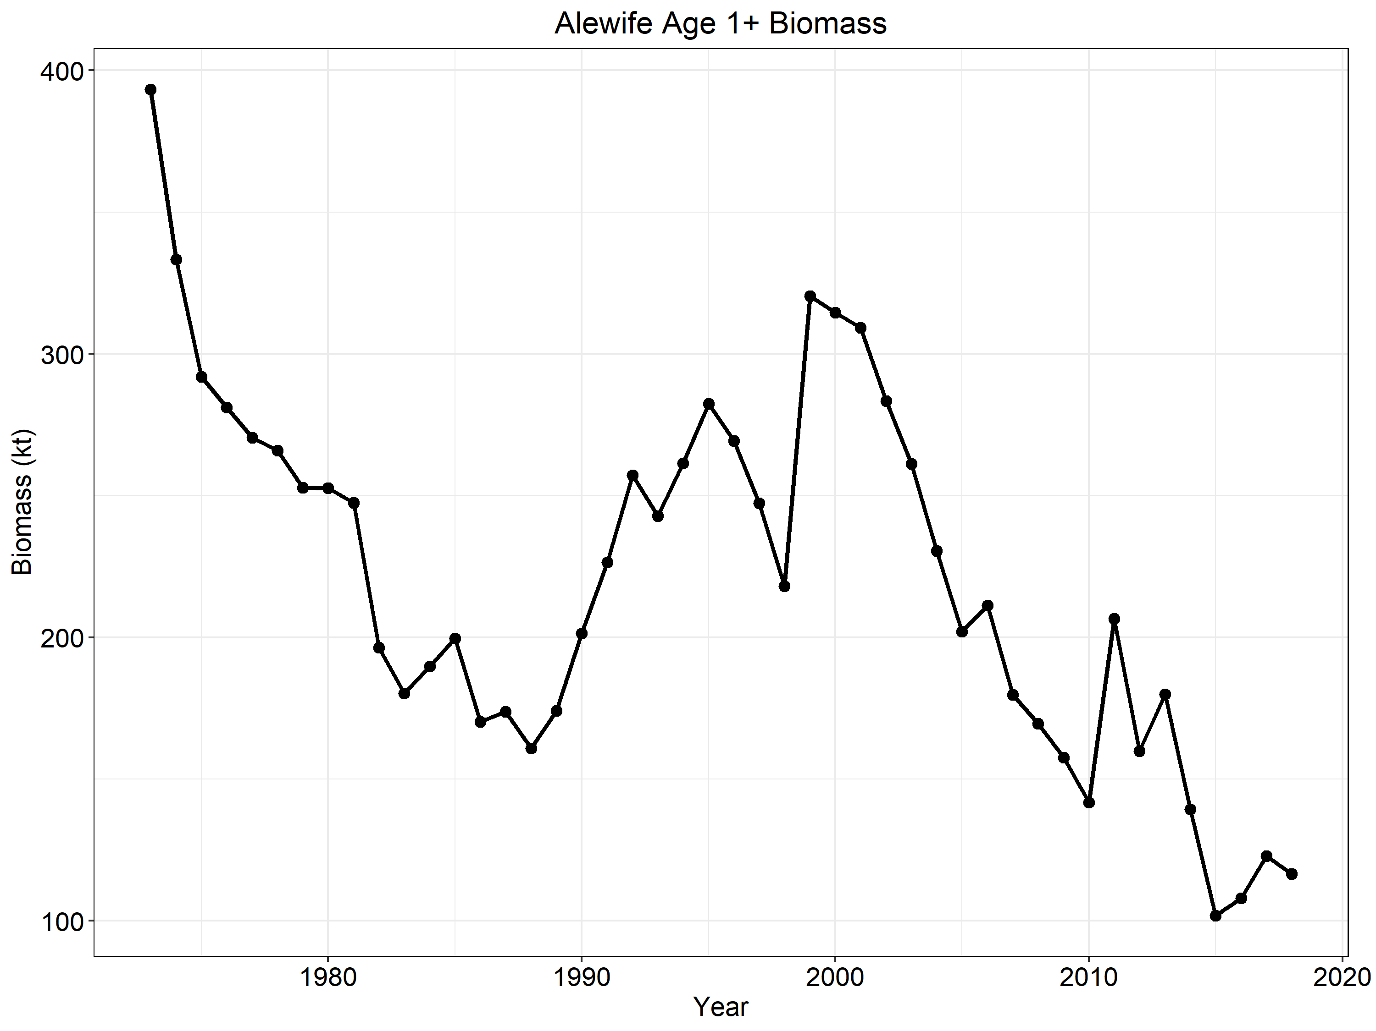
Notes:
Alewife biomass. Somewhat of an increasing trend in recent years although 2018 may be less than 2017.

Slide 25
Notes:
PPR estimates (bottom panel) calculated by dividing age 1+ Chinook biomass (top panel) by Age 1+ Alewife biomass (middle panel). The dashed lines indicate the upper (red) and lower (green) threshold for management action and 0.068 is the 2018 PPR. This year’s model run rescaled alewife biomass slightly upward in the recent time series which moved the entire PPR downward relative to previous years. There are perhaps two reasons for this change: 1) Bottom trawl catchability was allowed to estimate differently starting in 2015 when acoustic and bottom trawl alewife abundance estimates diverged (Warner, Bunnell, Turschak), 2) Chinook weight at age was estimated using an updated cohort based VonB growth model which better fits observed Chinook weight values (Turschak, Jonas, Clark).

Slide 26
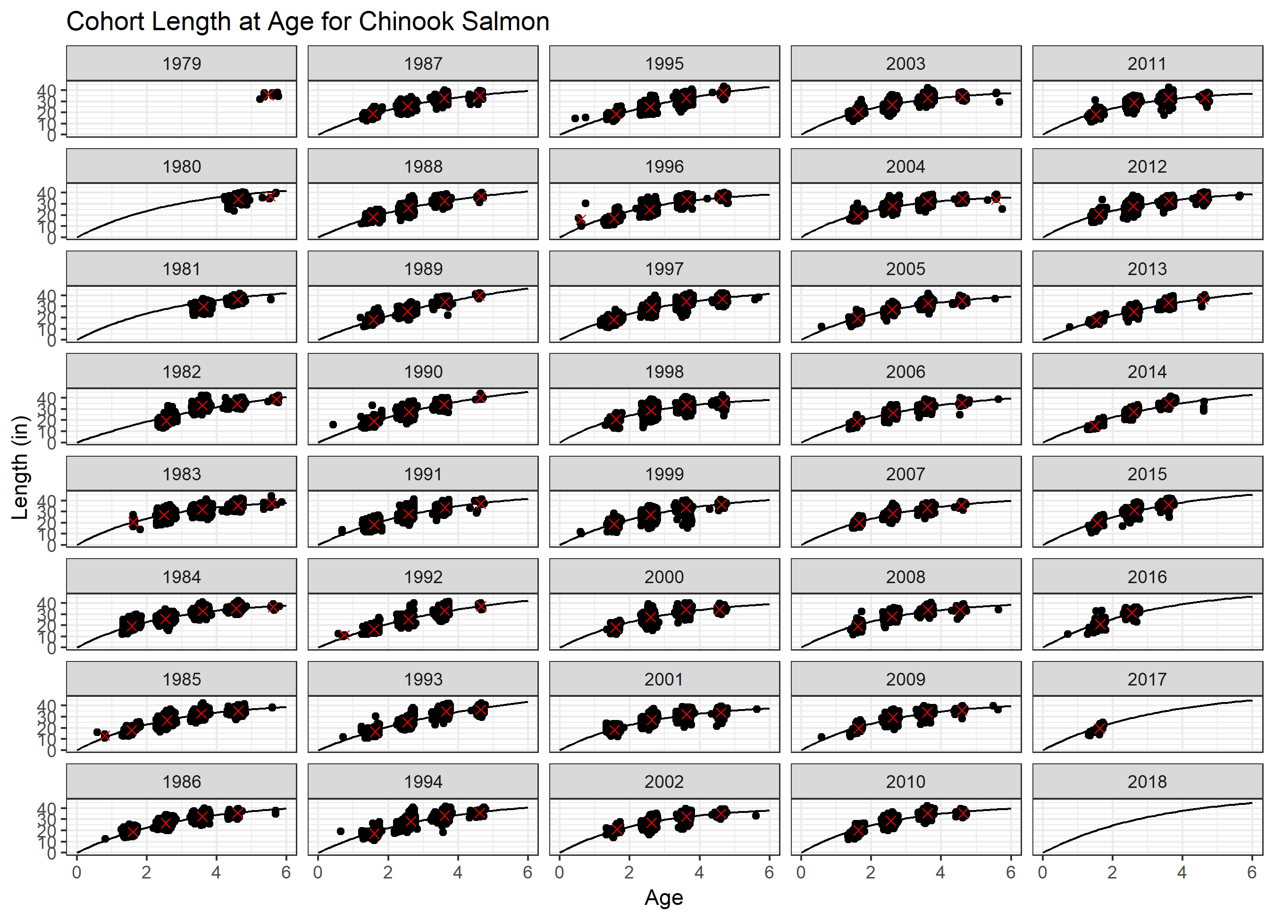
Notes:
Extra Slide demonstrating the fit of updated COHORT based VonB growth model to observed data.

